Slide 1
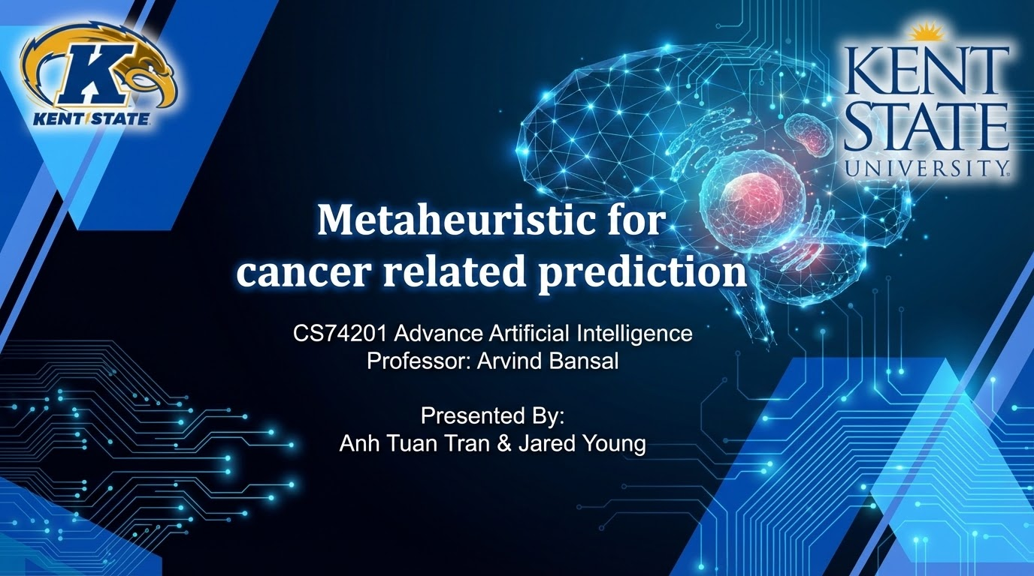




Metaheuristic for
cancer related prediction
CS74201 Advance Artificial Intelligence
Professor: Arvind Bansal
Presented By:
Anh Tuan Tran & Jared Young

Slide 2
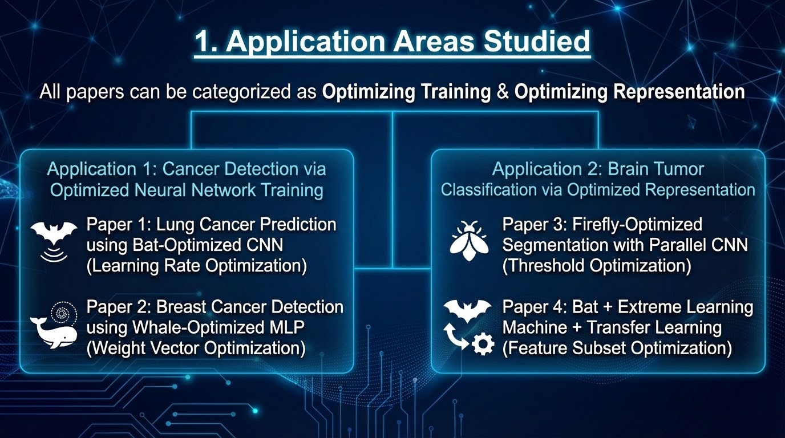
Application Areas Studied
All papers can be categorized as Optimizing Training & Optimizing Representation
Application 1: Cancer Detection via Optimized Neural Network Training
  Paper 1: Lung Cancer Prediction using Bat-Optimized CNN (Learning Rate Optimization)
  Paper 2: Breast Cancer Detection using Whale-Optimized MLP (Weight Vector Optimization)
Application 2: Brain Tumor Classification via Optimized Representation
  Paper 3: Firefly-Optimized Segmentation with Parallel CNN (Threshold Optimization)
  Paper 4: Bat + Extreme Learning Machine + Transfer Learning (Feature Subset Optimization)

Slide 3
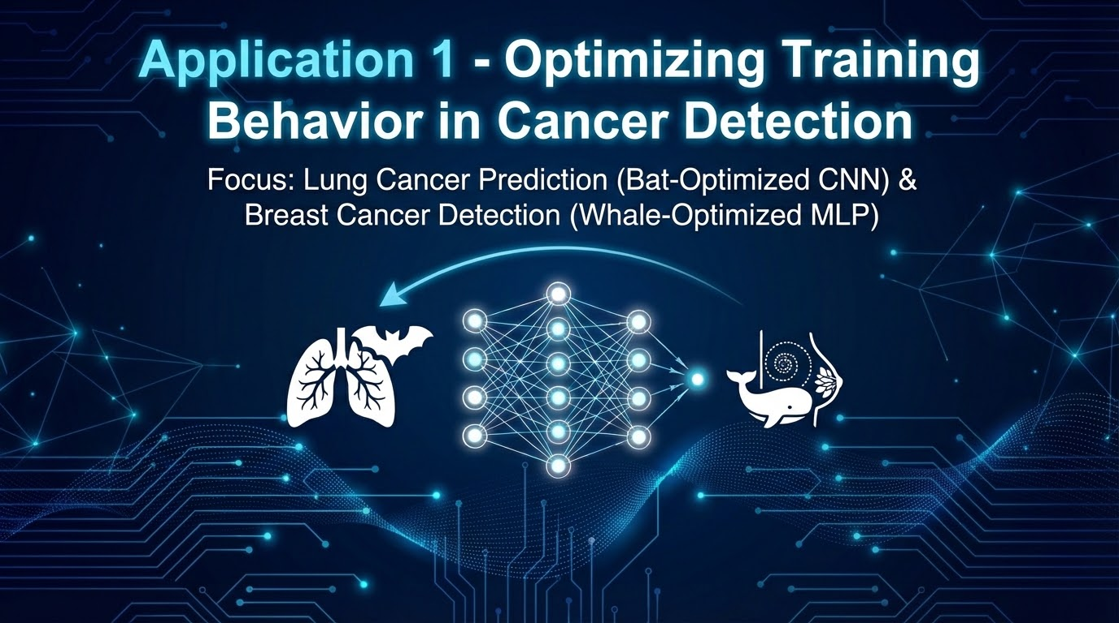
Application 1 - Optimizing Training Behavior in Brain Tumor Classification

Slide 4
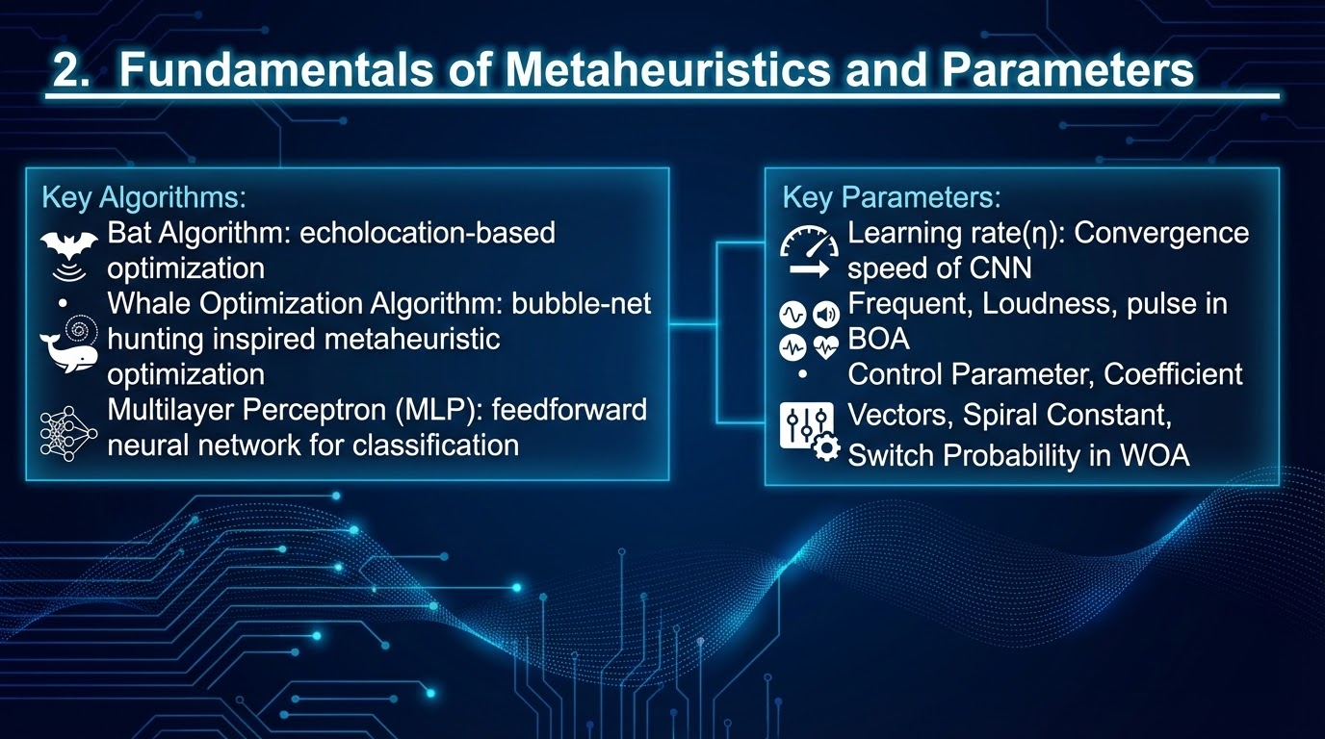
Fundamentals of Metaheuristics and Parameters
Key Algorithms:
Bat Algorithm: echolocation-based optimization
Whale Optimization Algorithm: bubble-net hunting inspired metaheuristic optimization
Multilayer Perceptron (MLP): feedforward neural network for classification
Key Parameters:
Learning rate(η): Convergence speed of CNN
Frequent, Loadness, pulse in BOA
Control Parameter, Coefficient Vectors, Spiral Constant, Switch Probability in WOA

Slide 5
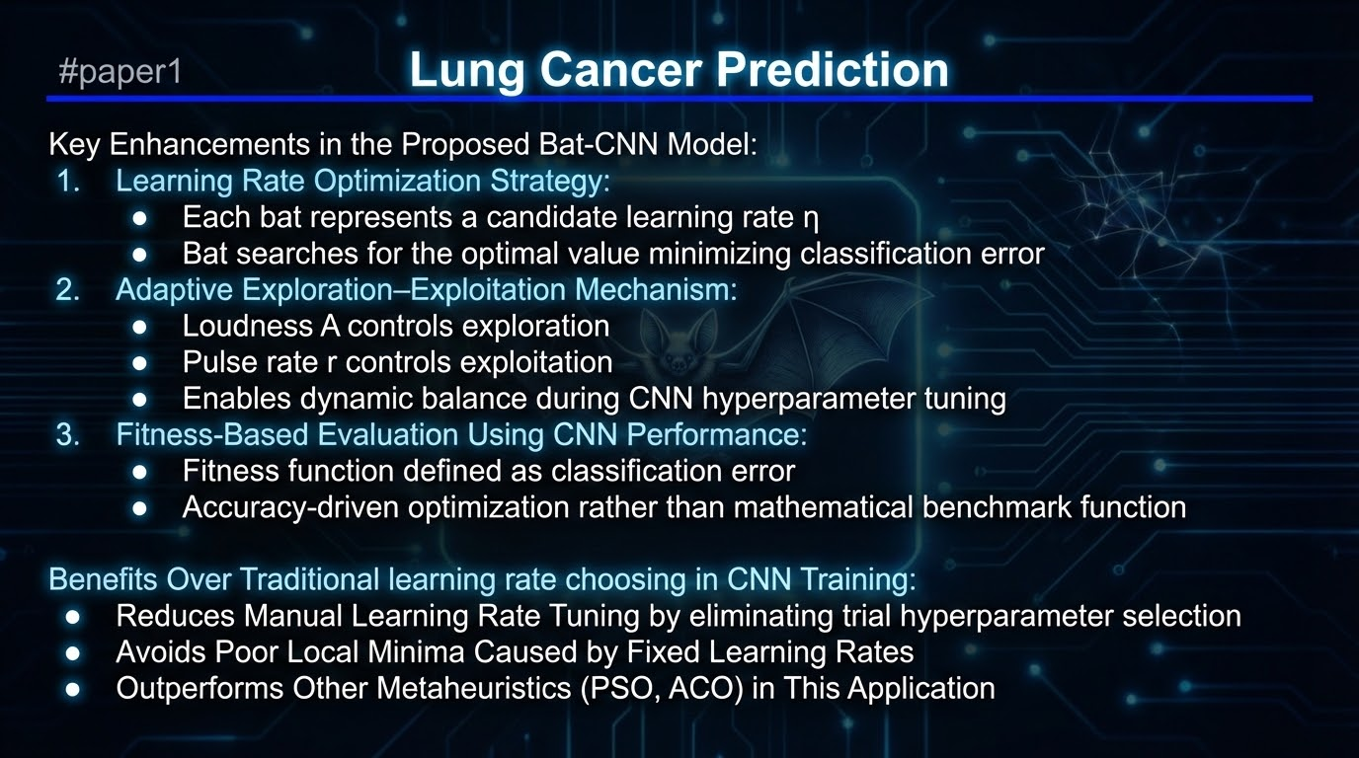
Lung Cancer Prediction
#paper1
Key Enhancements in the Proposed Bat-CNN Model:
Learning Rate Optimization Strategy
Each bat represents a candidate learning rate η
Bat searches for the optimal value minimizing classification error
Adaptive Exploration–Exploitation Mechanism
Loudness A controls exploration
Pulse rate r controls exploitation
Enables dynamic balance during CNN hyperparameter tuning
Fitness-Based Evaluation Using CNN Performance
Fitness function defined as classification error
Accuracy-driven optimization rather than mathematical benchmark function
Benefits Over Traditional learning rate choosing in CNN Training:
Reduces Manual Learning Rate Tuning by eliminating trial hyperparameter selection
Avoids Poor Local Minima Caused by Fixed Learning Rates
Outperforms Other Metaheuristics (PSO, ACO) in This Application

Slide 6
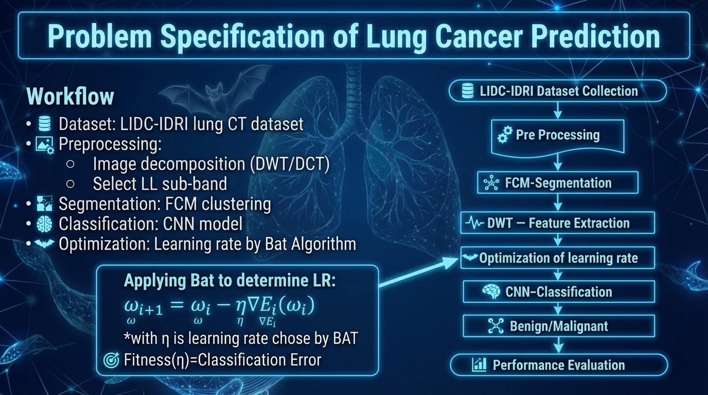
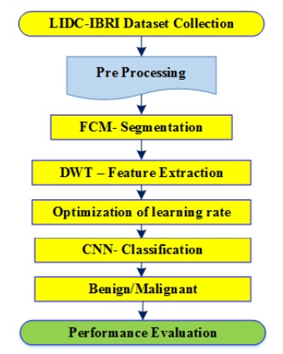
Problem Specification of Lung Cancer Prediction
For lung cancer prediction from CT cans, its workflow is:
Dataset: LIDC-IDRI lung CT dataset
Preprocessing:
  Image decomposition (DWT/DCT)
  Select LL sub-band
Segmentation by FCM clustering
Classification by CNN model
Optimization learning rate by Bat Algorithm
Applying Bat to determine LR:
ω_{i+1} = ω_{i} − η∇E_{i}(ω_{i})
*with η is learning rate chose by BAT
Fitness(η)=Classification Error

Slide 7
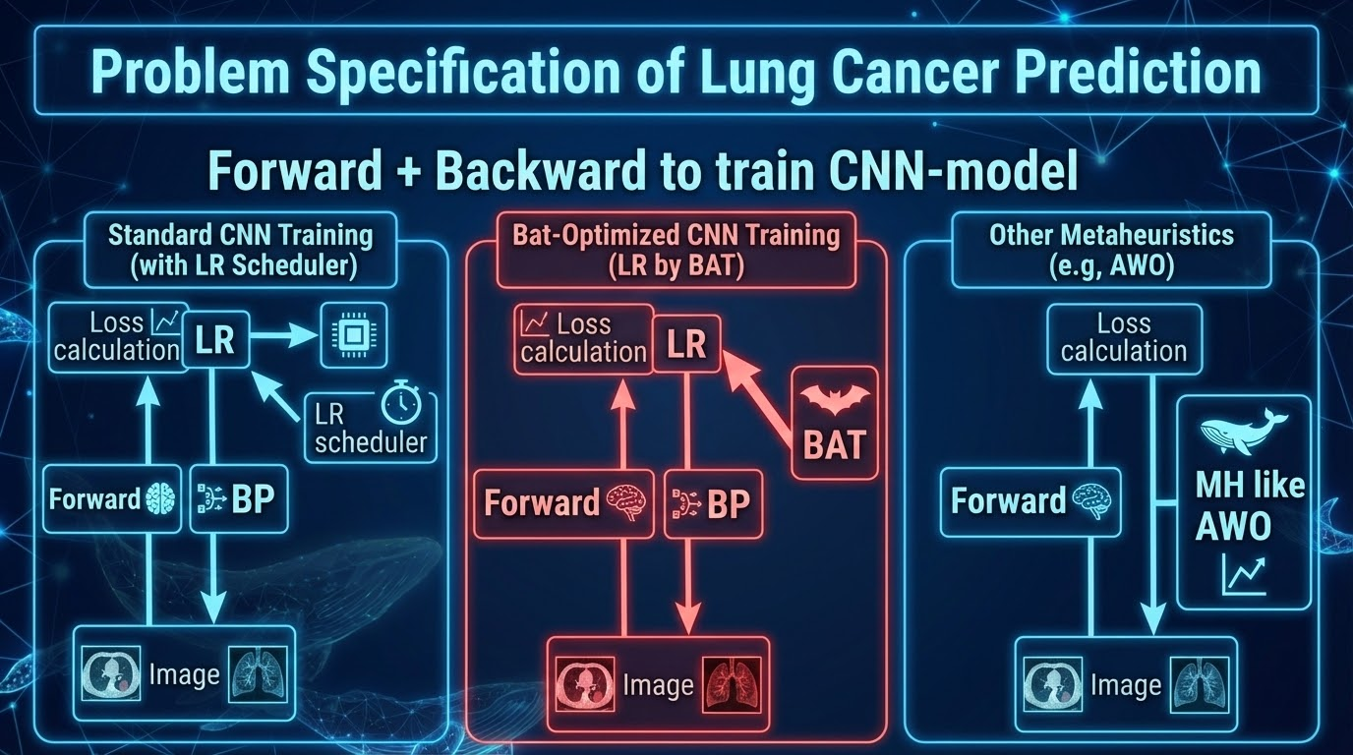
Problem Specification of Lung Cancer Prediction
Forward + Backward to train CNN-model
Loss calculation
Loss calculation
Loss calculation
LR
LR
LR scheduler
(BAT)
Forward
BP
Forward
MH like
AWO
Forward
BP
Image
Image
Image

Slide 8
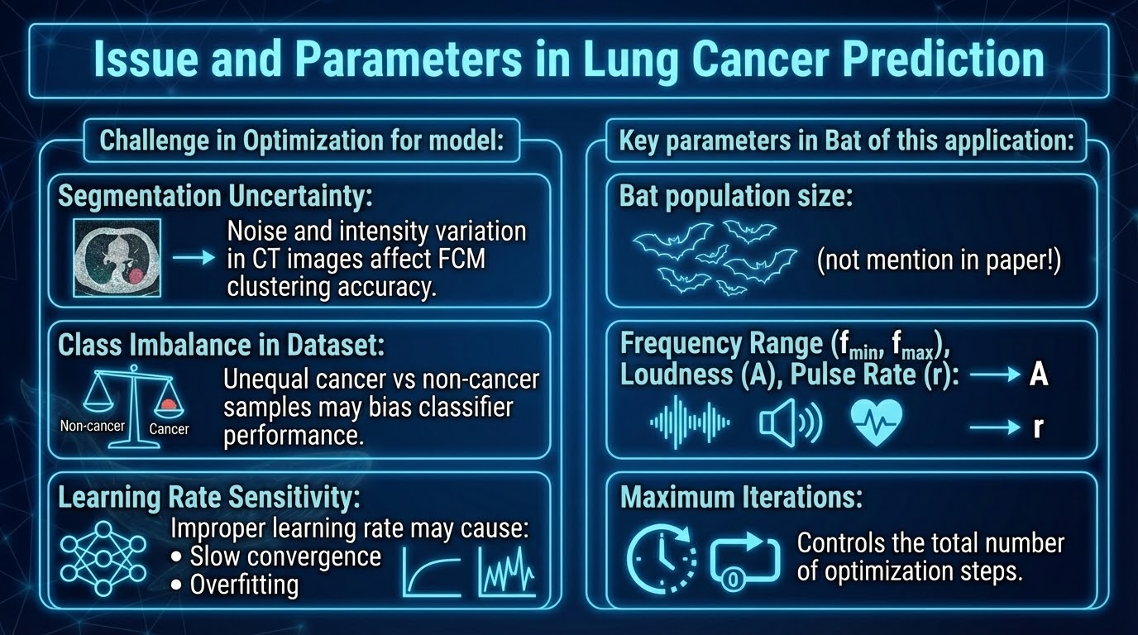
Issues and Parameters in Lung Cancer Prediction
Challenge in Optimization for model:
Segmentation Uncertainty: Noise and intensity variation in CT images affect FCM clustering accuracy.
Class Imbalance in Dataset: Unequal cancer vs non-cancer samples may bias classifier performance.
Learning Rate Sensitivity, Improper learning rate may cause:Slow convergence, Overfitting
Key parameters in Bat of this application:
Bat population size: not mention in paper!
Frequency Range (fmin, fmax), Loudness (A), Pulse Rate (r)
Maximum Iterations

Slide 9
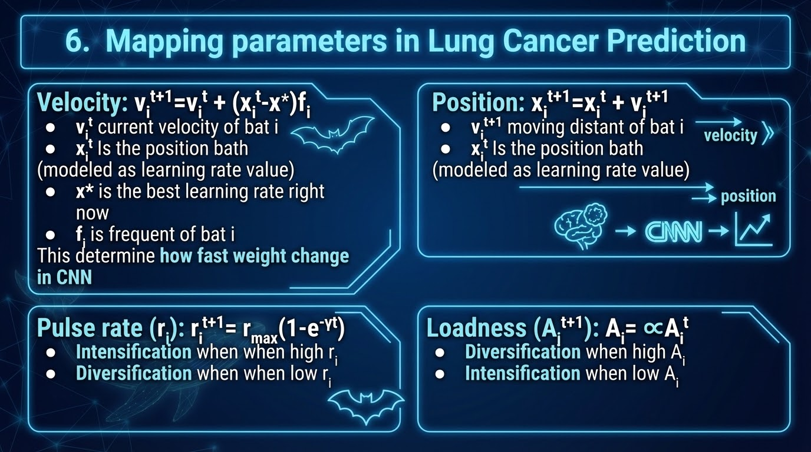
Mapping parameters in Lung Cancer Prediction
Velocity: v_{i}^{t+1}=v_{i}^{t} + (x_{i}^{t}-x*)f_{i}
v_{i}^{t} current velocity of bat i
x_{i}^{t} Is the position bath
(modeled as learning rate value)
x* is the best learning rate right now
F_{i} is frequent of bath i
This determine how fast weight change in CNN
Position: x_{i}^{t+1}=x_{i}^{t} + v_{i}^{t+1}
v_{i}^{t+1} moving distant of bat i
x_{i}^{t} Is the position bath
(modeled as learning rate value)
Pulse rate (r_{i}):r_{i}^{t+1}= r_{max}(1-e^{-yt})
Intensification when when high r_{i}
Diversification when when low r_{i}
Loadness (A_{i}^{t+1}) A_{i}= ∝A_{i}^{t}
Diversification when high A_{i}
Intensification when low A_{i}

Slide 10
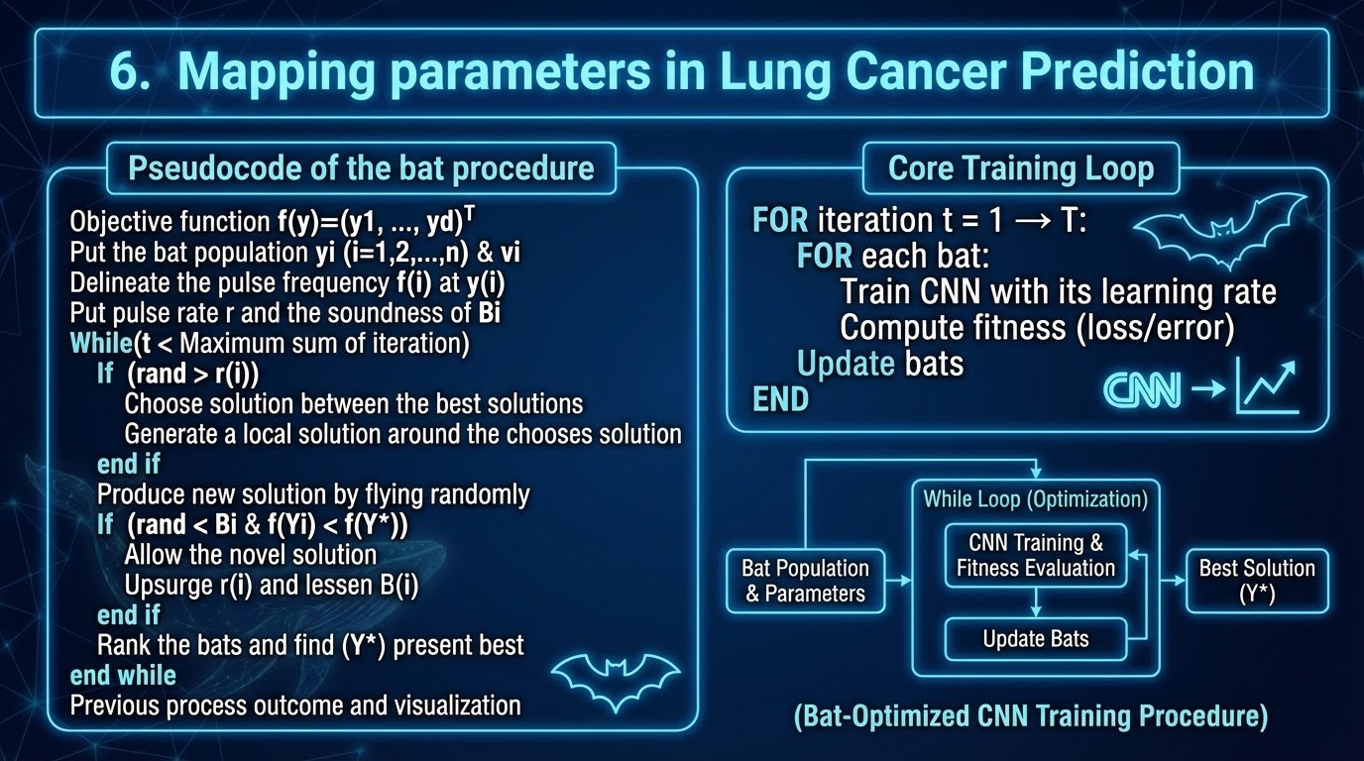
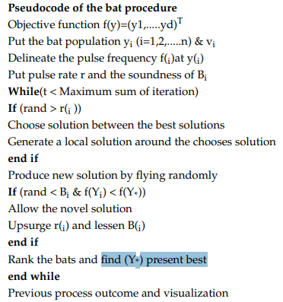
Mapping parameters in Lung Cancer Prediction
FOR iteration t = 1 → T:
FOR each bat:
Train CNN with its learning rate
Compute fitness (loss/error)
Update bats
END
(Pseudocode in Paper)

Slide 11
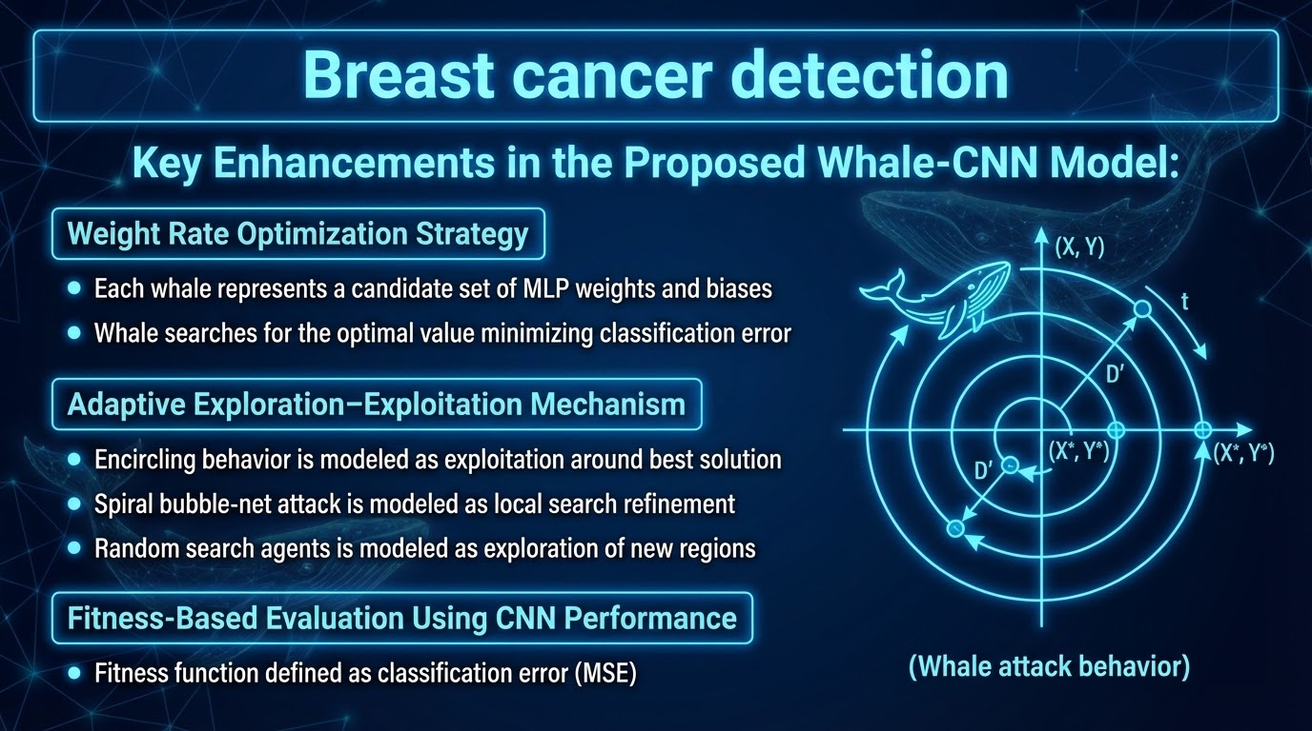
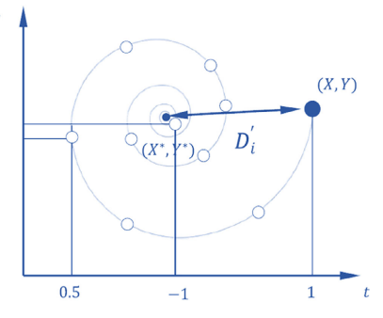
Breast cancer detection
#paper2
Key Enhancements in the Proposed Whale-CNN Model:
Weight Rate Optimization Strategy
Each whale represents a candidate set of MLP weights and biases
Whale searches for the optimal value minimizing classification error
Adaptive Exploration–Exploitation Mechanism
Encircling behavior is modeled as exploitation around best solution
Spiral bubble-net attack is modeled as local search refinement
Random search agents is modeled as exploration of new regions
Fitness-Based Evaluation Using CNN Performance
Fitness function defined as classification error(MSE)
(Whale attack behavior)

Slide 12
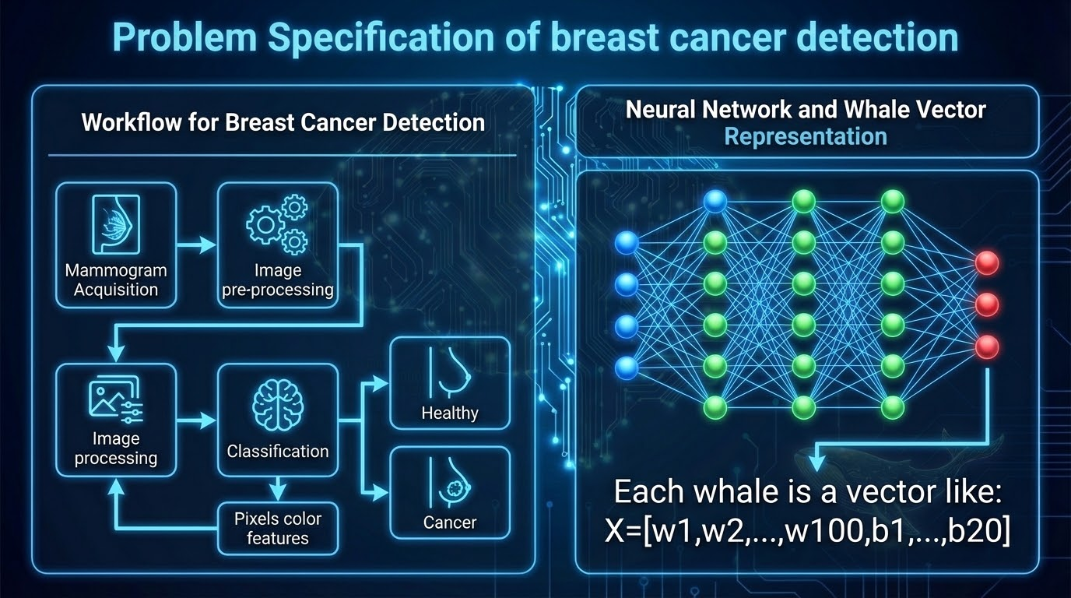
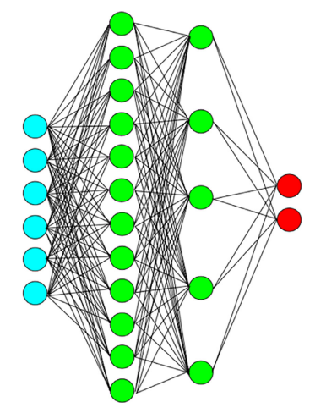
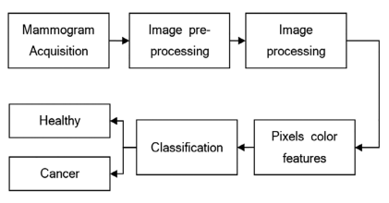
Problem Specification of breast cancer detection
For breast cancer detection, its workflow is:
Each whale is a vector like:
X=[w₁​,w_{2​},...,w₁₀₀​,b₁​,...,b_{20​}]

Slide 13
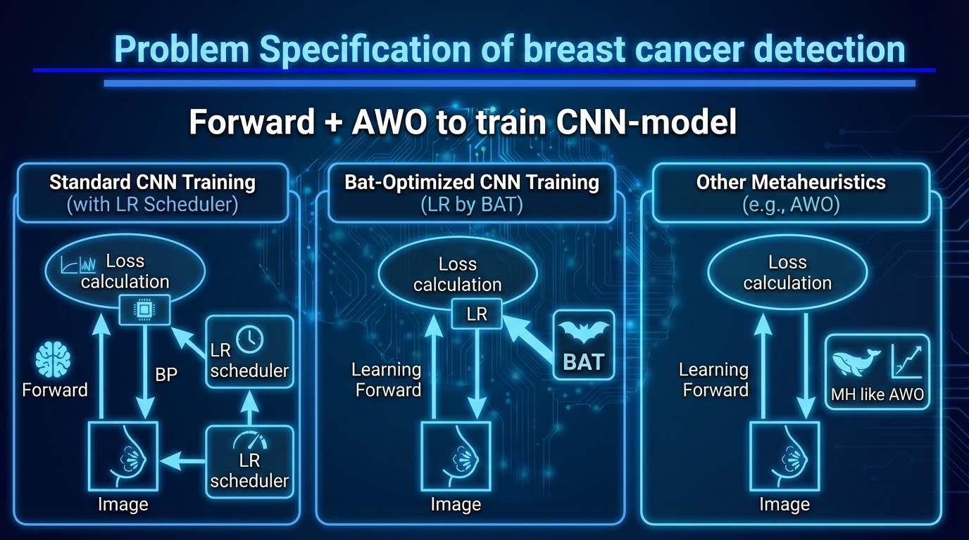
Problem Specification of breast cancer detection
Forward + AWO to train CNN-model
Loss calculation
Loss calculation
Loss calculation
LR
LR
LR scheduler
(BAT)
Forward
BP
Forward
MH like
AWO
Forward
BP
Image
Image
Image

Slide 14
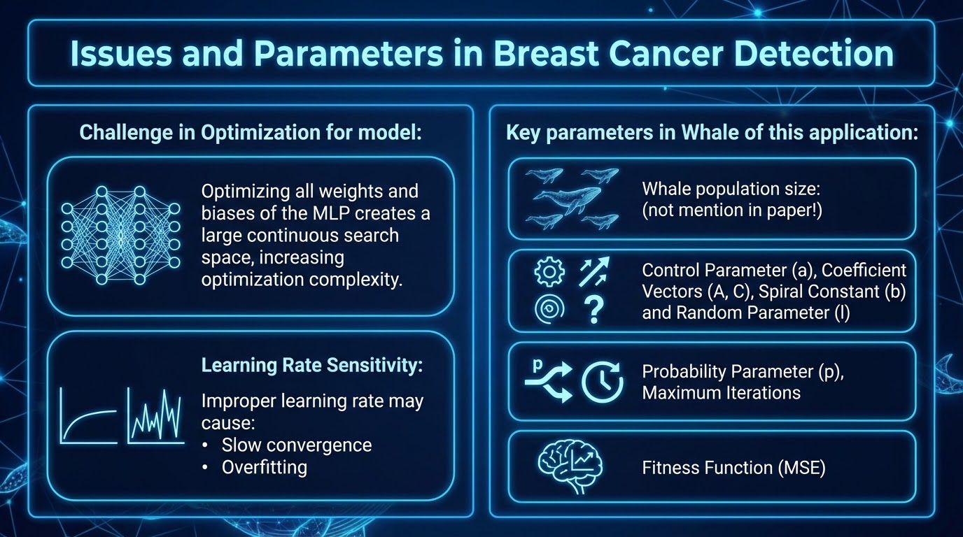
Issues and Parameters in breast cancer detection
Challenge in Optimization for model:
Optimizing all weights and biases of the MLP creates a large continuous search space, increasing optimization complexity.
Learning Rate Sensitivity, Improper learning rate may cause:Slow convergence, Overfitting
Key parameters in Whale of this application:
Whale population size: not mention in paper!
Control Parameter (a)
Coefficient Vectors (A, C)
Spiral Constant (b) and Random Parameter (l)
Probability Parameter (p)
Maximum Iterations
Fitness Function(MSE)

Slide 15
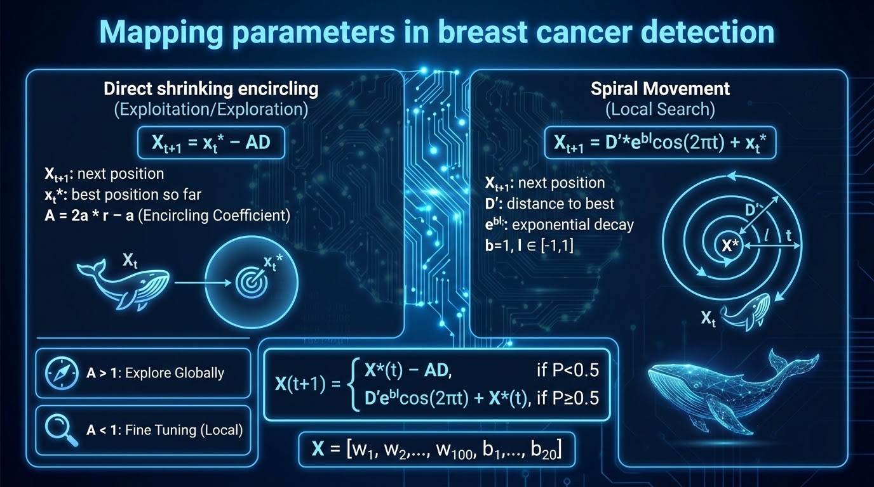

Mapping parameters in breast cancer detection
Direct shrinking encircling:
X_{t+1} = x_{t}*-AD
X_{t+1} is the next position
x_{t}* is the best position so far
A is encilring Coefficient
= 2a * r - a
With a is linearly decrease from 2 to 0
A > 1: explore globally
A < 1: fine tuning weight locally
=> move straight toward the best solution
Spiral Movement: X_{t+1} = D’*e^{bl}cos(2πt)+x_{t}*
X_{t+1} is the next position
D’ is distance between X_{t} and best solution
e^{bl} is exponential decay term(b=1)(l ∊ [-1,1])
=> move around the best solution in a spiral
(With P and r is random value from 0 to 1)
X=[w₁​,w_{2​},...,w₁₀₀​,b₁​,...,b_{20​}]

Slide 16
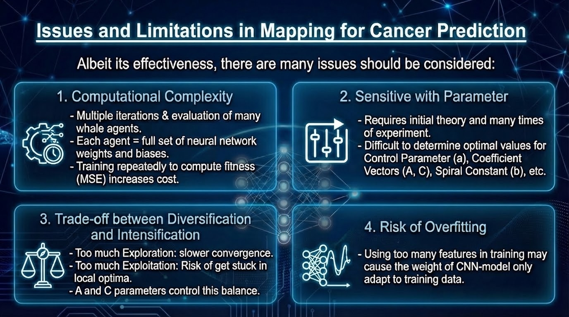
issues and Limitations in Mapping for Cancer Prediction
Albeit its effectiveness, there are many issues should be considered:
Computational Complexity: The algorithm requires multiple iterations and evaluation of many whale agents, each representing a full set of neural network weights and biases. Training the network repeatedly to compute fitness (MSE) increases computational cost.
Sensitive with parameter: require initial theory and many times of experiment.
Trade-off between Diversification and Intensification:
Too much Exploration: slower convergence
Too much Exploitation: Risk of get stuck in local optima
Risk of Overfitting: Using too many features in training may cause the weight of CNN-model only adapt to training data.

Slide 17
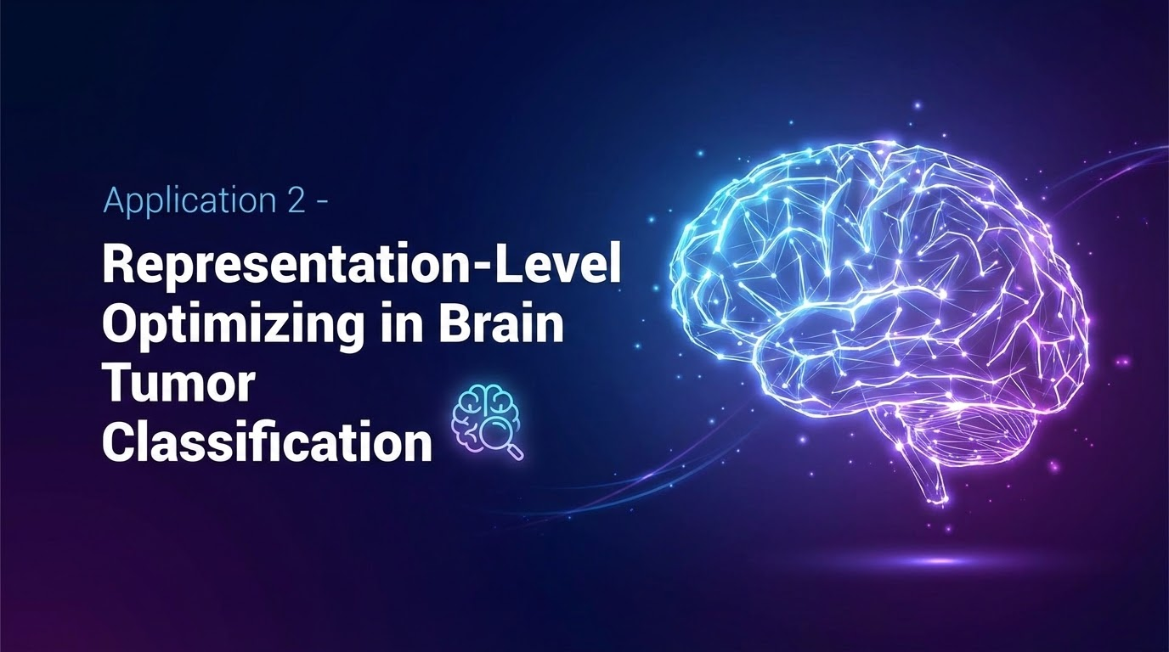
Application 2 - Representation-Level Optimizing in Brain Tumor Classification

Slide 18
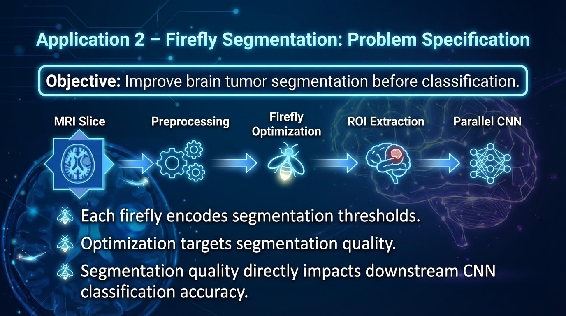
Application 2 – Firefly Segmentation: Problem Specification
Objective: Improve brain tumor segmentation before classification.
  Pipeline: MRI Slice → Preprocessing → Firefly Optimization → ROI Extraction → Parallel CNN.
  Each firefly encodes segmentation thresholds.
  Optimization targets segmentation quality.
  Segmentation quality directly impacts downstream CNN classification accuracy.

Slide 19
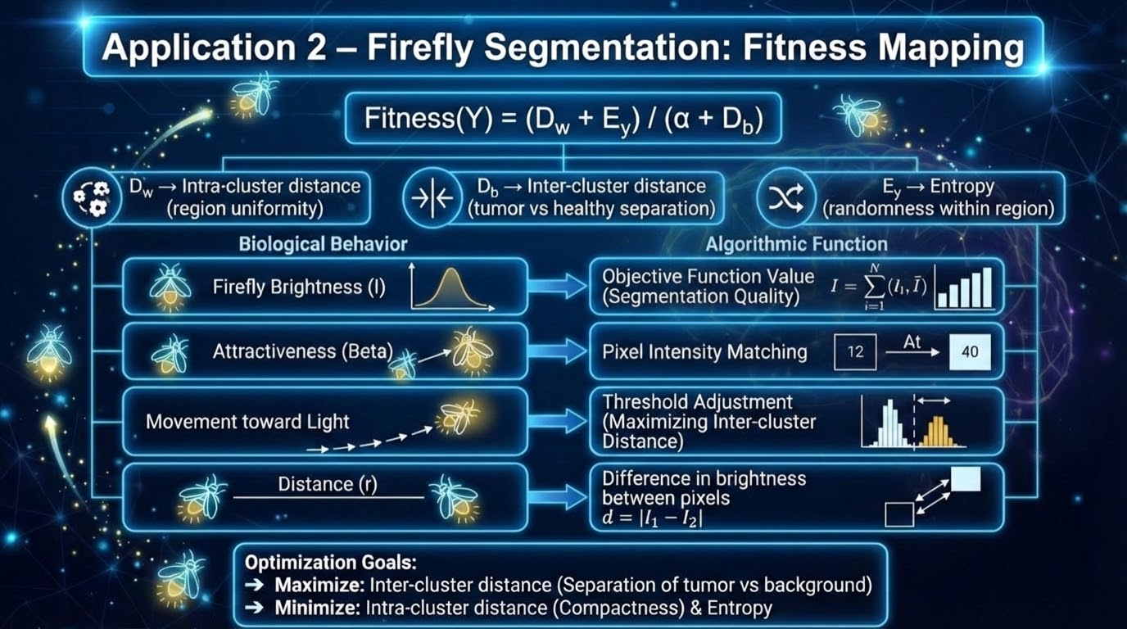
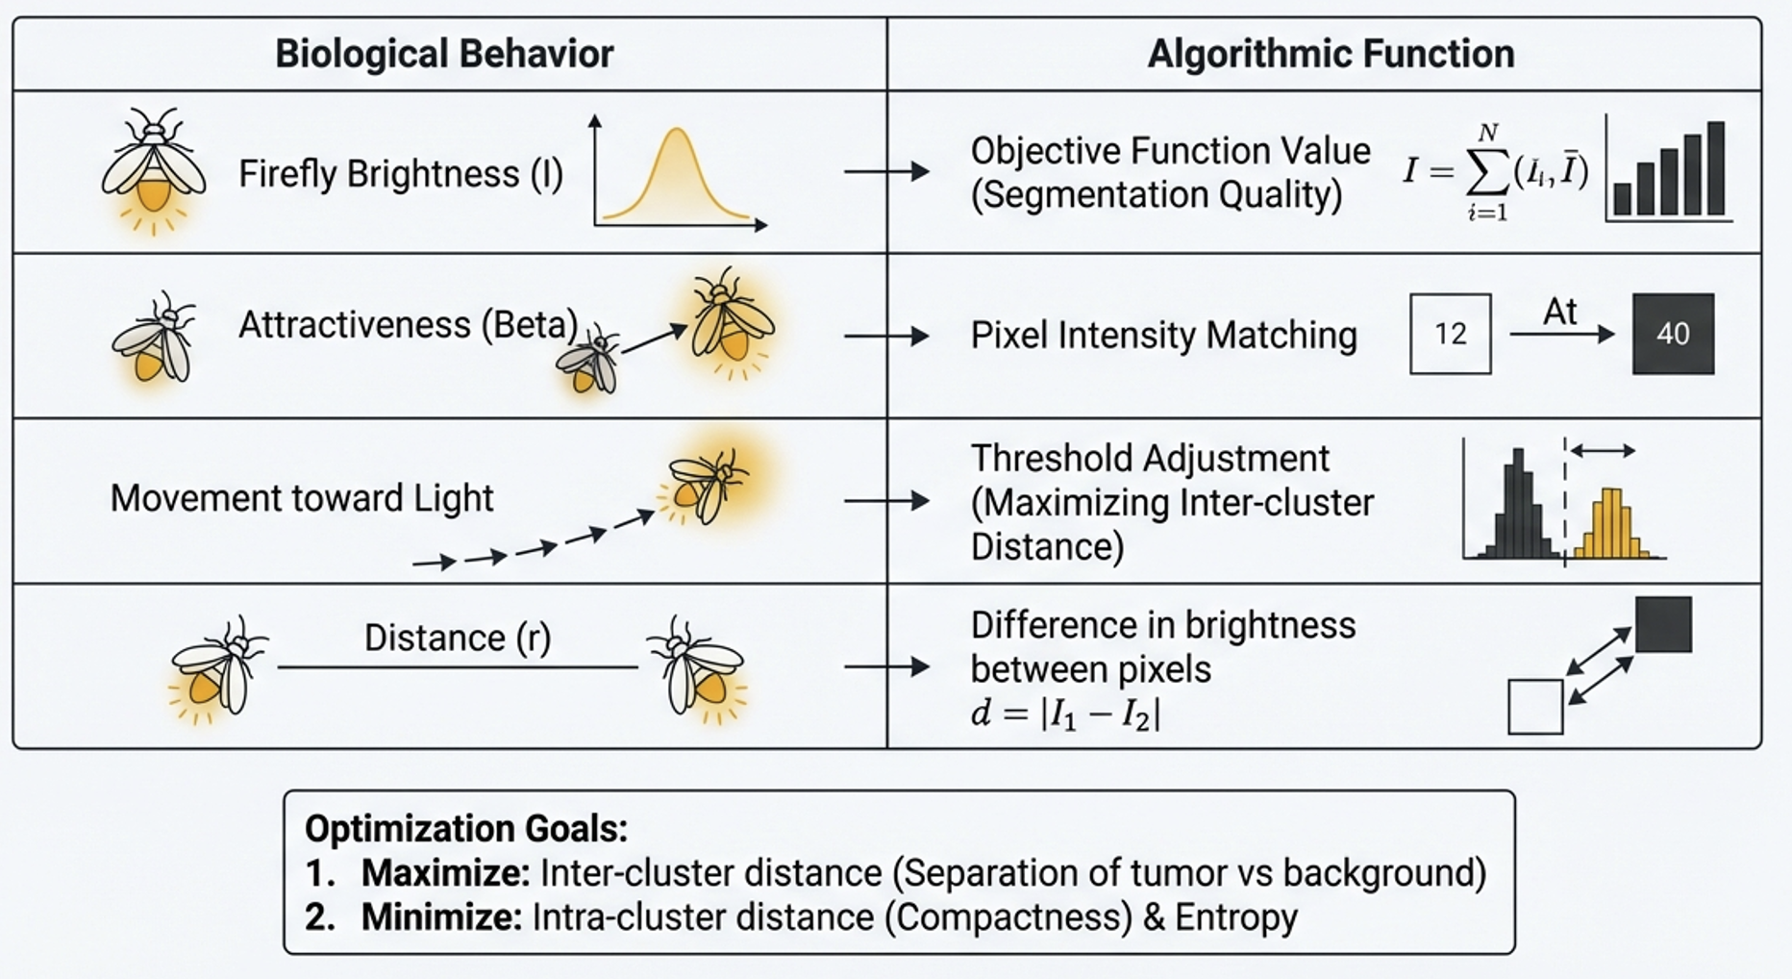
Application 2 – Firefly Segmentation: Fitness Mapping
Fitness(Y) = (D_w + E_y) / (α + D_b).
  D_w → Intra-cluster distance (region uniformity).
  D_b → Inter-cluster distance (tumor vs healthy separation).
  E_y → Entropy (randomness within region).
  Optimization goal: Maximize inter-cluster separation while minimizing intra-cluster variance and entropy.

Slide 20
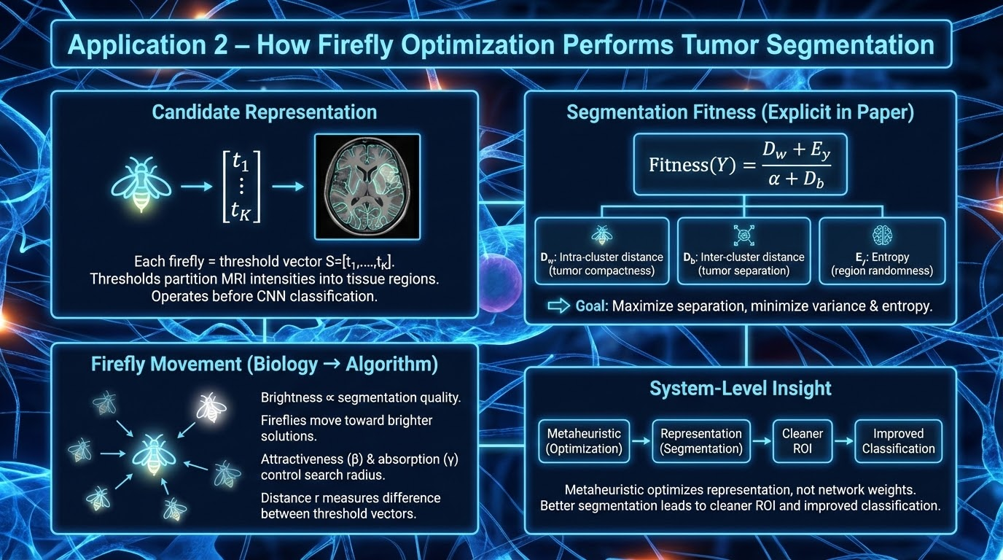
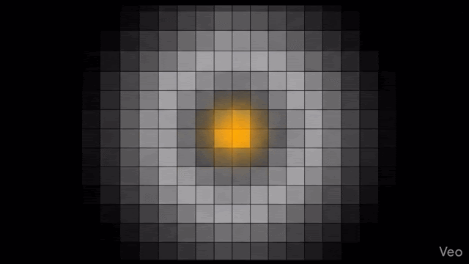
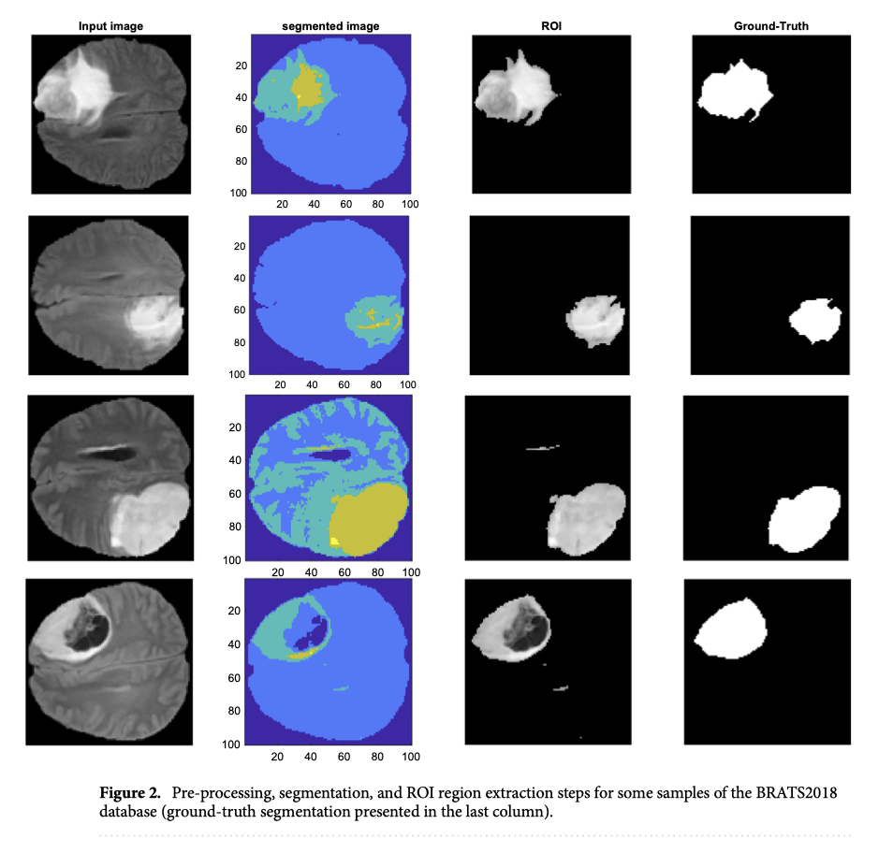

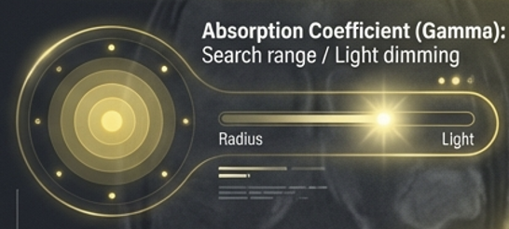
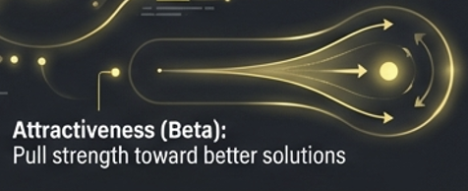
Application 2 - How Firefly Optimization Performs Tumor Segmentation
Candidate Representation
• Each firefly = threshold vector S=[t1,…,tK]S = [t_1, …, t_K]S=[t1​,…,tK​]
• Thresholds partition MRI intensities into tissue regions
• Operates before CNN classification
Segmentation Fitness (Explicit in Paper)
Fitness(Y)=Dw+Eyα+DbFitness(Y) = \frac{D_w + E_y}{\alpha + D_b}Fitness(Y)=α+Db​Dw​+Ey​​
• DwD_wDw​: intra-cluster distance (tumor compactness)
• DbD_bDb​: inter-cluster distance (tumor separation)
• EyE_yEy​: entropy (region randomness)
Goal → Maximize separation, minimize variance & entropy
Firefly Movement (Biology → Algorithm)
• Brightness ∝ segmentation quality
• Fireflies move toward brighter solutions
• Attractiveness (β) & absorption (γ) control search radius
• Distance rrr measures difference between threshold vectors
(movement equation assumed from canonical Firefly model)
System-Level Insight
Metaheuristic optimizes representation, not network weights.
Better segmentation → cleaner ROI → improved classification.

Slide 21
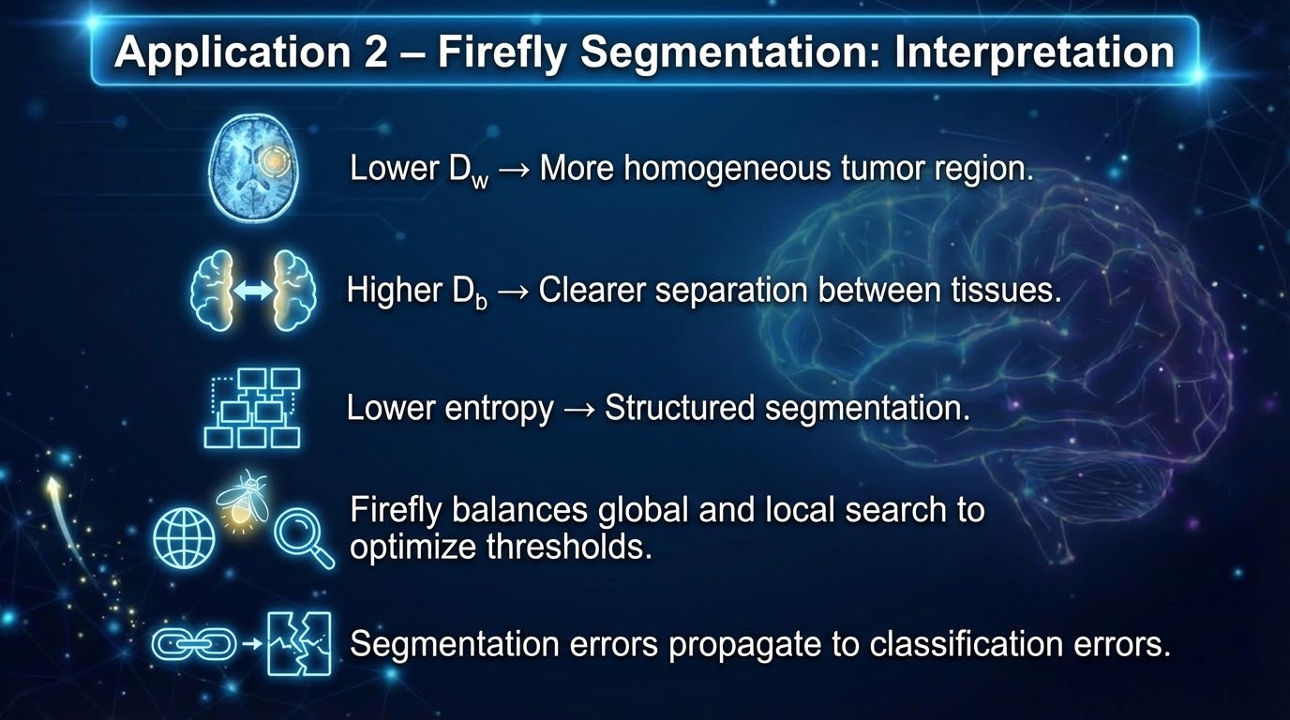
Application 2 – Firefly Segmentation: Interpretation
Lower D_w → More homogeneous tumor region.
  Higher D_b → Clearer separation between tissues.
  Lower entropy → Structured segmentation.
  Firefly balances global and local search to optimize thresholds.
  Segmentation errors propagate to classification errors.

Slide 22
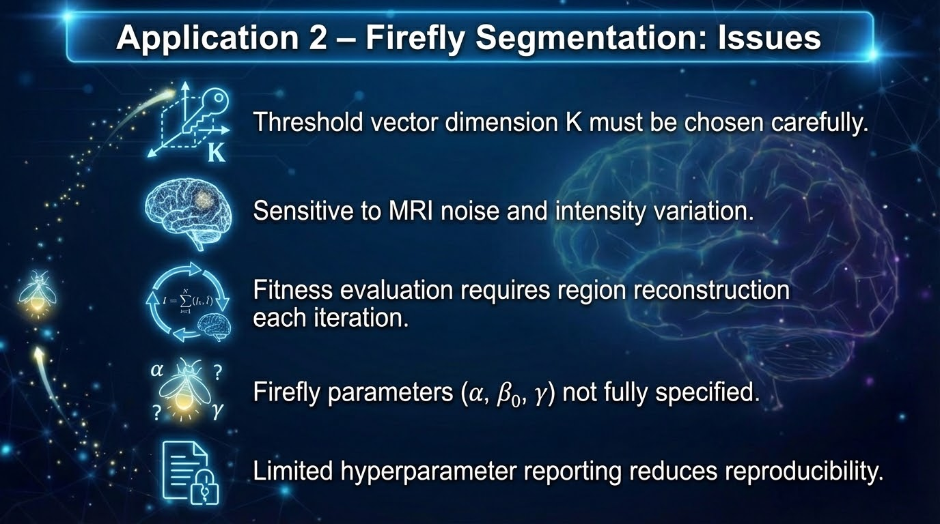
Application 2 – Firefly Segmentation: Issues
Threshold vector dimension K must be chosen carefully.
  Sensitive to MRI noise and intensity variation.
  Fitness evaluation requires region reconstruction each iteration.
  Firefly parameters (α, β₀, γ) not fully specified.
  Limited hyperparameter reporting reduces reproducibility.

Slide 23
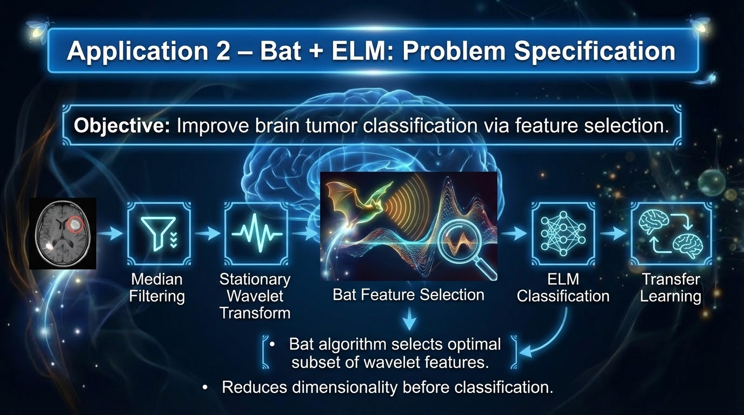
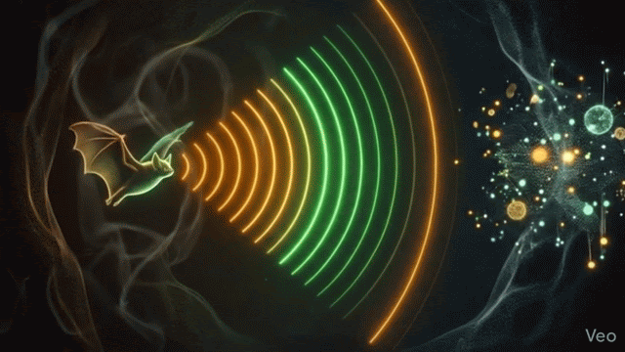
Application 2 – Bat + ELM: Problem Specification
Objective: Improve brain tumor classification via feature selection.
  Pipeline: Median Filtering → Stationary Wavelet Transform → Bat Feature Selection → ELM Classification → Transfer Learning.
  Bat algorithm selects optimal subset of wavelet features.
  Reduces dimensionality before classification.

Slide 24
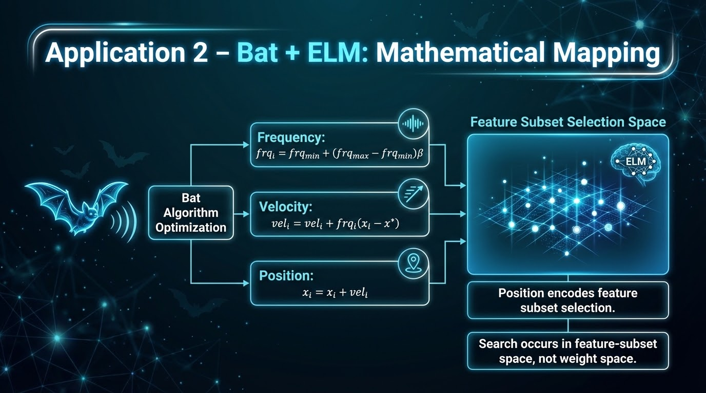
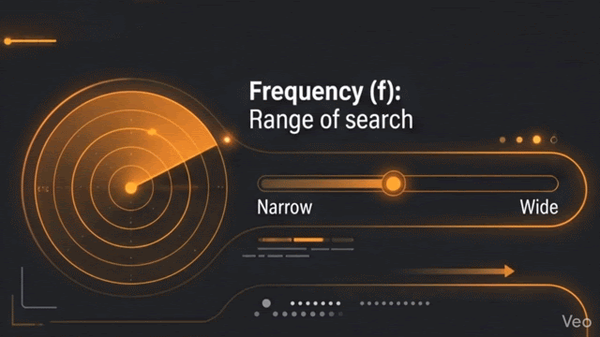
Application 2 – Bat + ELM: Mathematical Mapping
Frequency: frqᵢ = frq_min + (frq_max − frq_min)β.
  Velocity: velᵢ = velᵢ + frqᵢ(xᵢ − x*).
  Position: xᵢ = xᵢ + velᵢ.
  Position encodes feature subset selection.
  Search occurs in feature-subset space, not weight space.

Slide 25
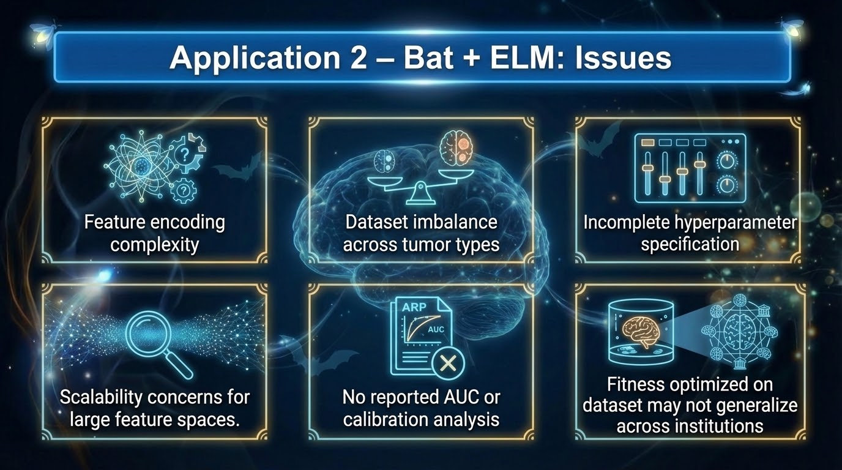
Application 2 – Bat + ELM: Issues
Feature encoding complexity.
  Dataset imbalance across tumor types.
  Incomplete hyperparameter specification.
  Scalability concerns for large feature spaces.
  No reported AUC or calibration analysis.
  Fitness optimized on dataset may not generalize across institutions.

Slide 26
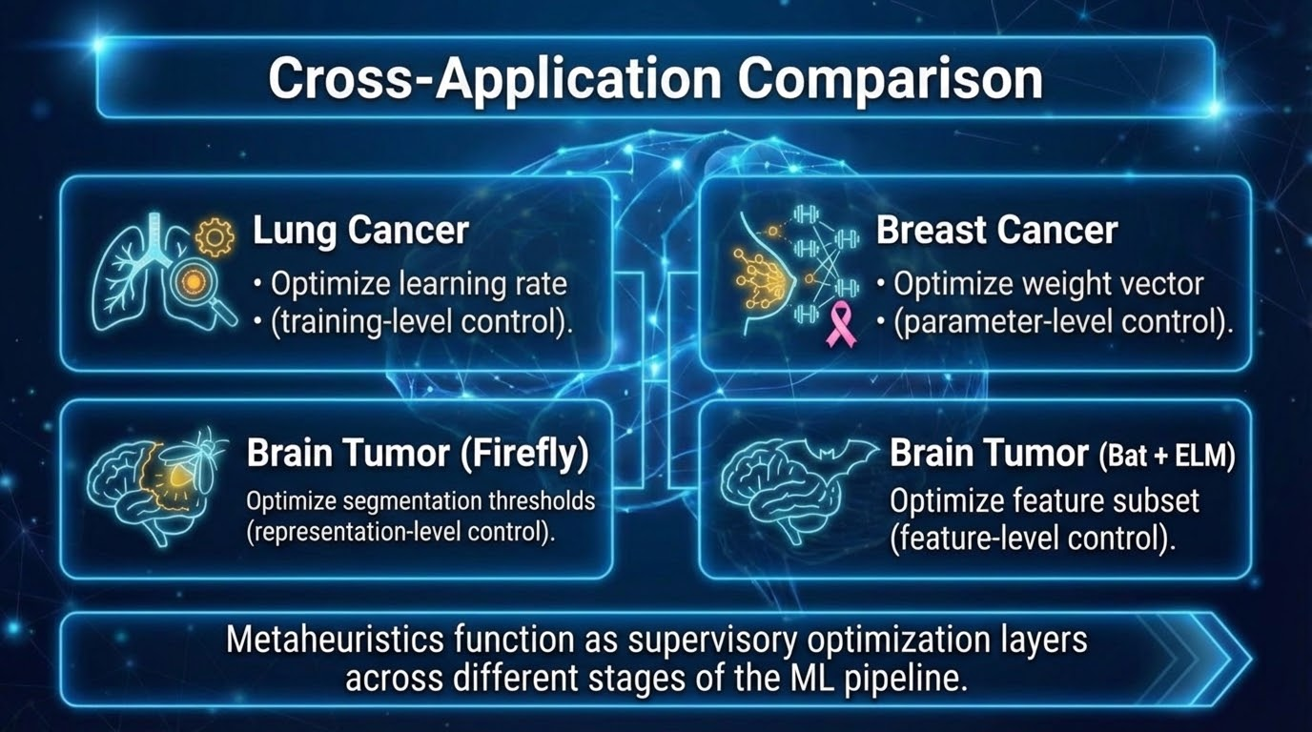
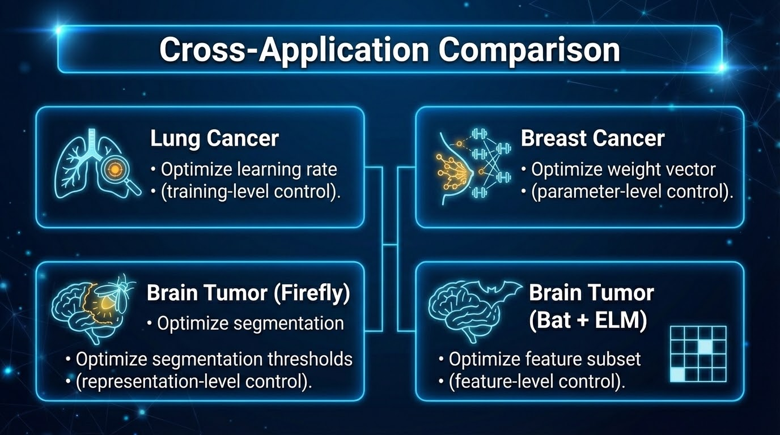
Cross-Application Comparison
Lung Cancer → Optimize learning rate (training-level control).
  Breast Cancer → Optimize weight vector (parameter-level control).
  Brain Tumor (Firefly) → Optimize segmentation thresholds (representation-level control).
  Brain Tumor (Bat + ELM) → Optimize feature subset (feature-level control).
  Metaheuristics function as supervisory optimization layers across different stages of the ML pipeline.

Slide 27
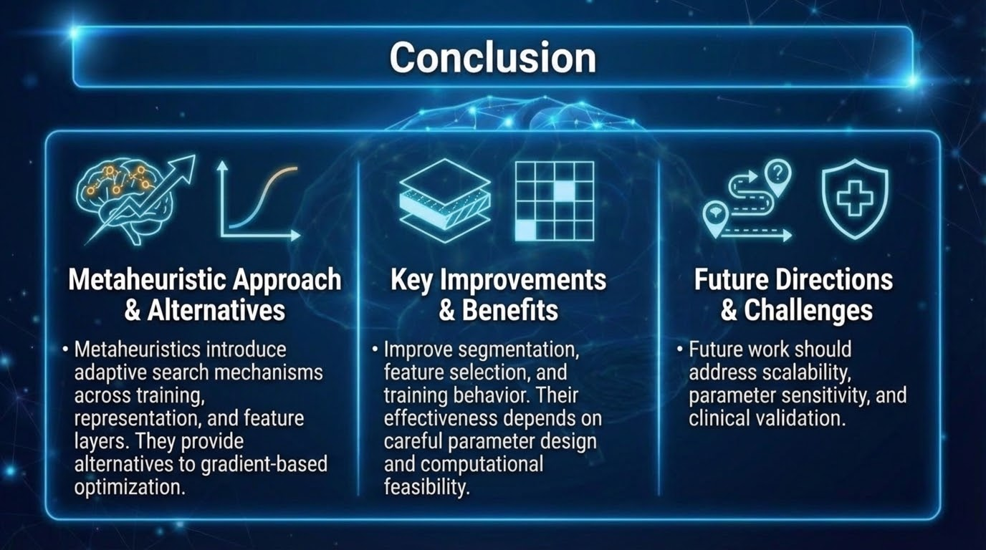
Conclusion
Metaheuristics introduce adaptive search mechanisms across training, representation, and feature layers.
  They provide alternatives to gradient-based optimization.
  Improve segmentation, feature selection, and training behavior.
  Future work should address scalability, parameter sensitivity, and clinical validation.
  Their effectiveness depends on careful parameter design and computational feasibility.

Slide 28
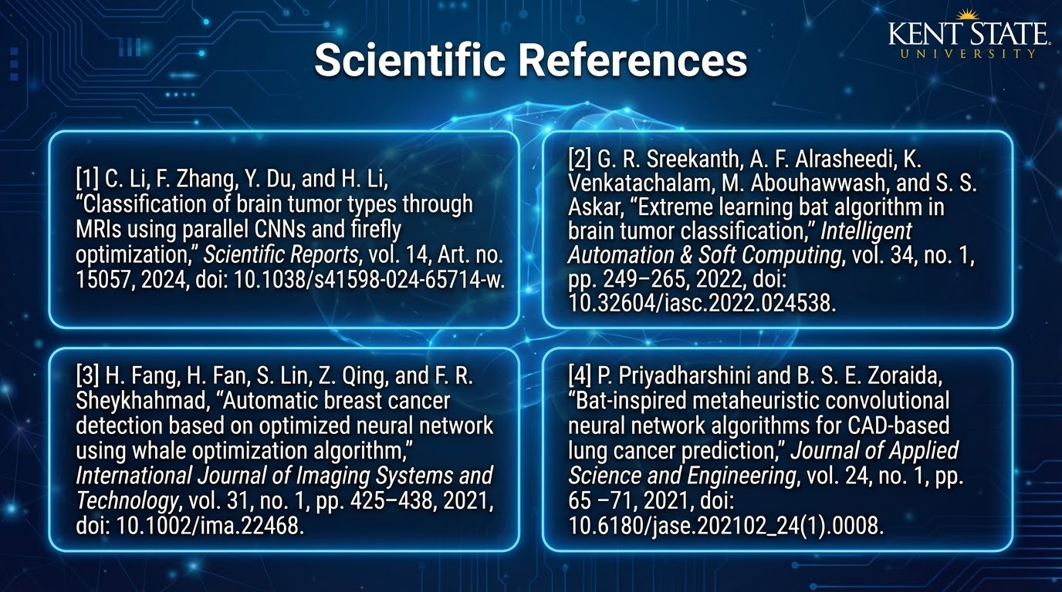
References
[1] C. Li, F. Zhang, Y. Du, and H. Li, “Classification of brain tumor types through MRIs using parallel CNNs and firefly optimization,” Scientific Reports, vol. 14, Art. no. 15057, 2024, doi: 10.1038/s41598-024-65714-w
[2] G. R. Sreekanth, A. F. Alrasheedi, K. Venkatachalam, M. Abouhawwash, and S. S. Askar, “Extreme learning bat algorithm in brain tumor classification,” Intelligent Automation & Soft Computing, vol. 34, no. 1, pp. 249–265, 2022, doi: 10.32604/iasc.2022.024538.
[3] H. Fang, H. Fan, S. Lin, Z. Qing, and F. R. Sheykhahmad, “Automatic breast cancer detection based on optimized neural network using whale optimization algorithm,” International Journal of Imaging Systems and Technology, vol. 31, no. 1, pp. 425–438, 2021, doi: 10.1002/ima.22468.
[4] P. Priyadharshini and B. S. E. Zoraida, “Bat-inspired metaheuristic convolutional neural network algorithms for CAD-based lung cancer prediction,” Journal of Applied Science and Engineering, vol. 24, no. 1, pp. 65–71, 2021, doi: 10.6180/jase.202102_24(1).0008.

