Slide 1
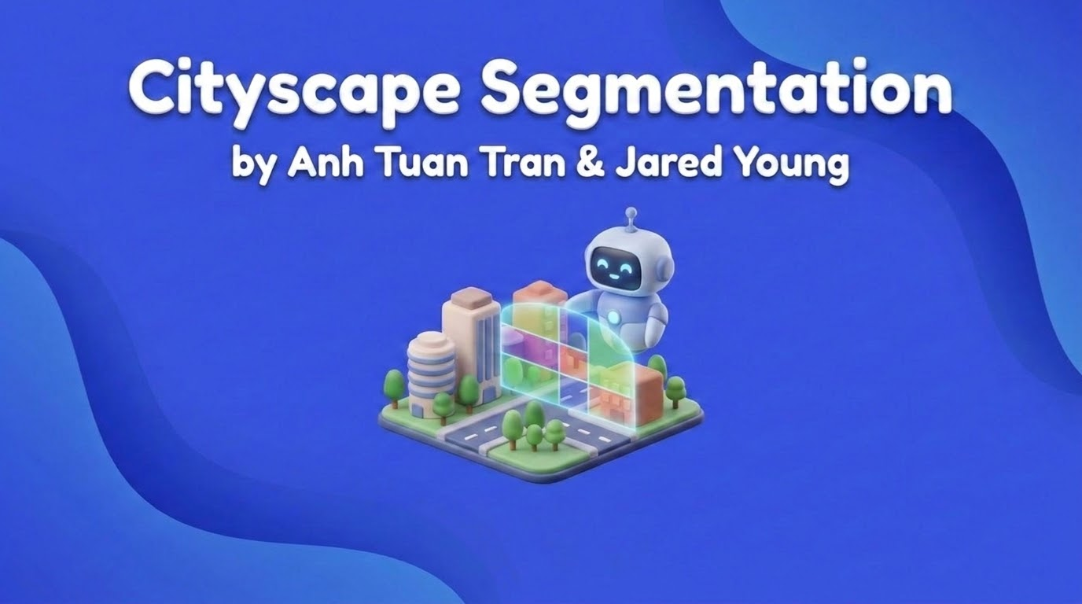

Slide 2
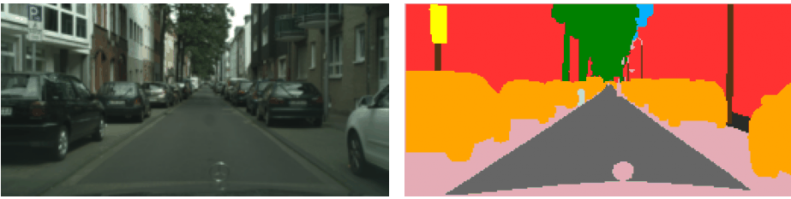
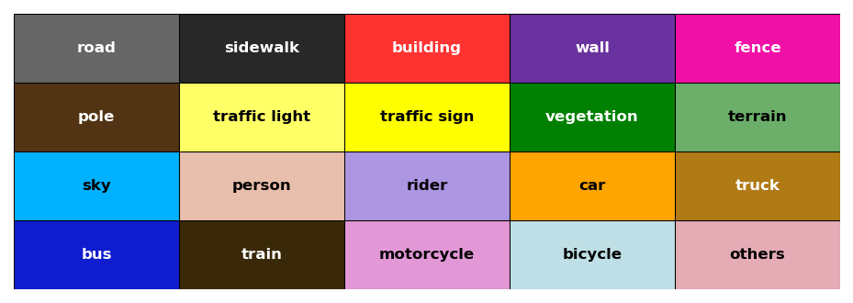
Project Overview
Why this project matters:
Autonomous systems need detailed urban scene understanding
Cityscapes segmentation classifies every pixel in street scenes
Segmented masks separate roads, cars, people, signs, and terrain
We extend masks into explainable scene analysis signals
Raw input → semantic mask → class meaning
02

Slide 3
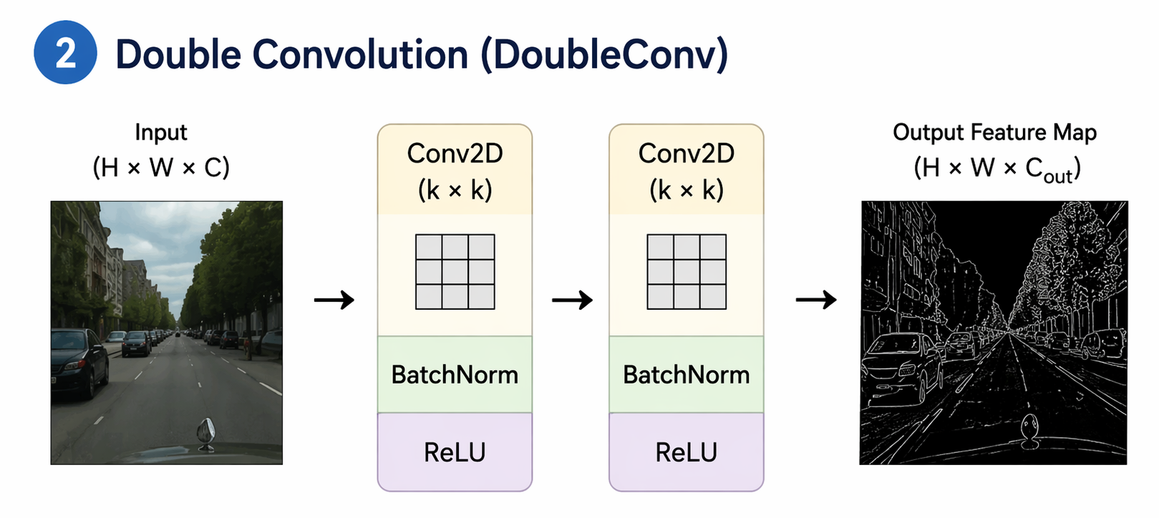
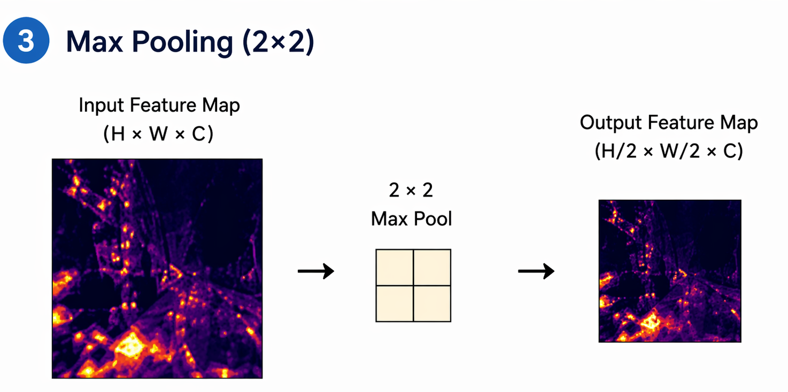
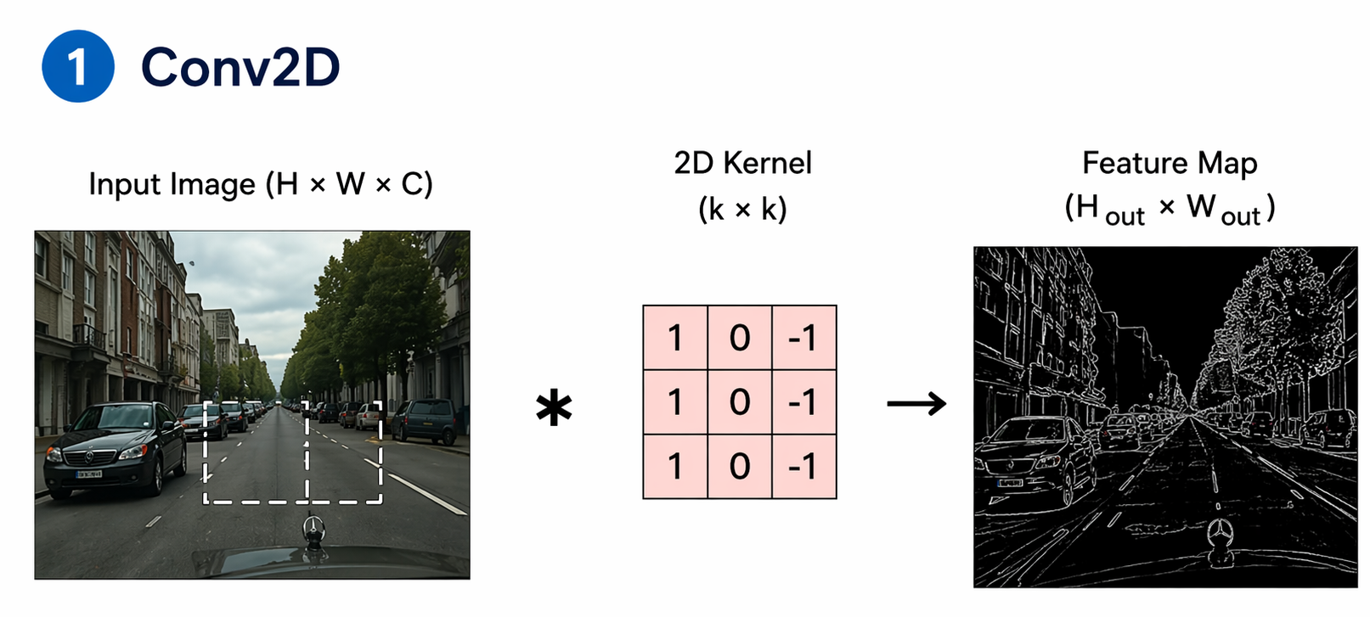
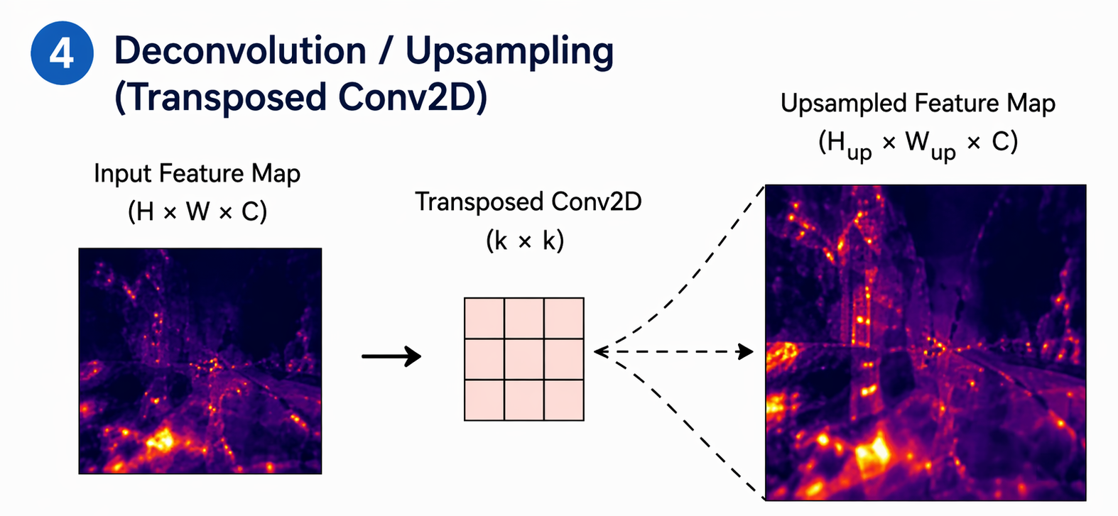
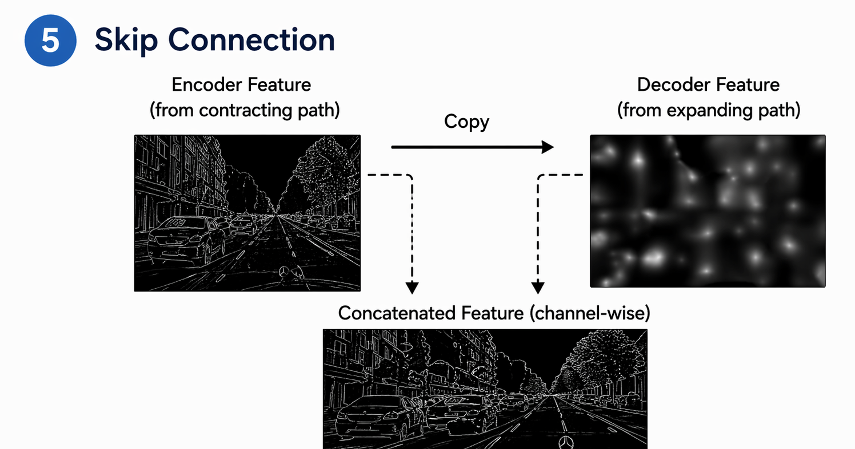
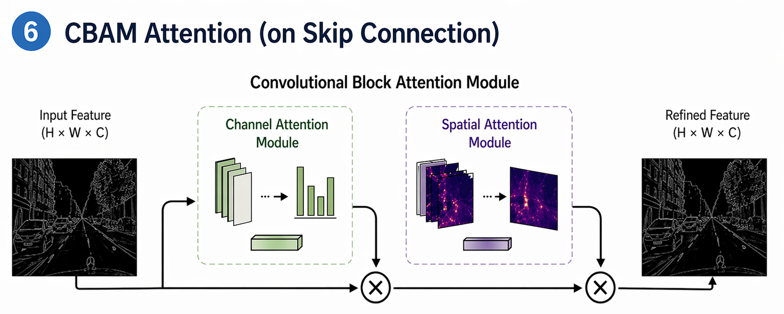
Arithmetic Operations in Our Project
03

Slide 4
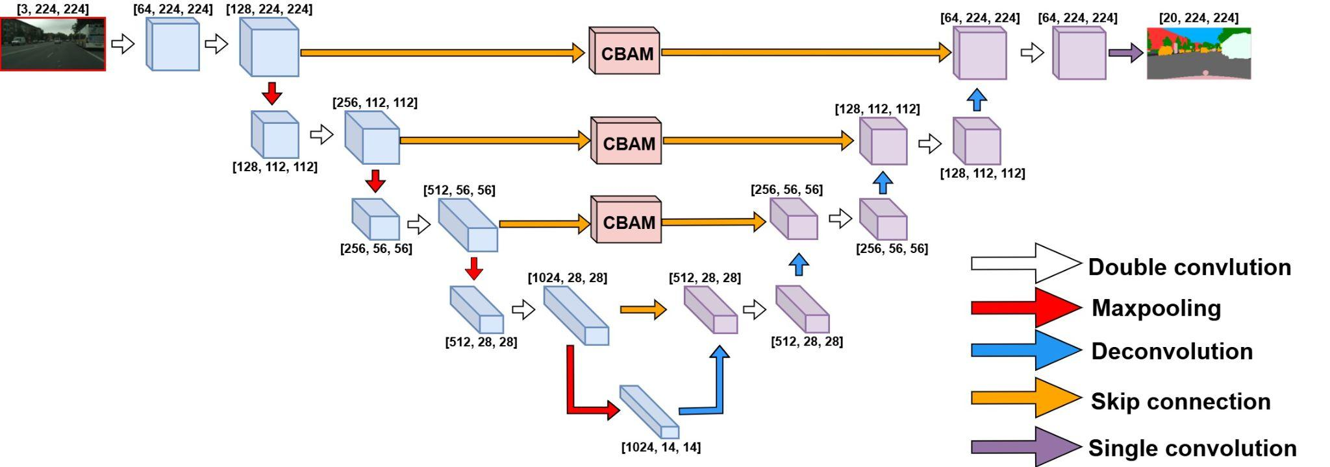
Encoder–Decoder Segmentation Model(Our proposed)
Figure 1: UNET-CBAM Architecture
04

Slide 5
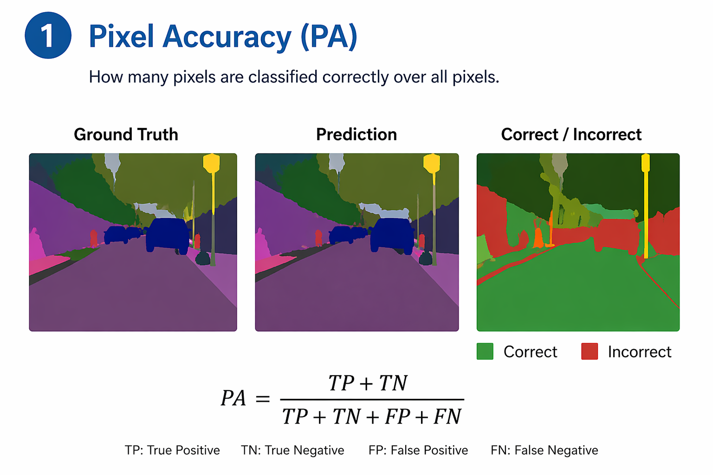
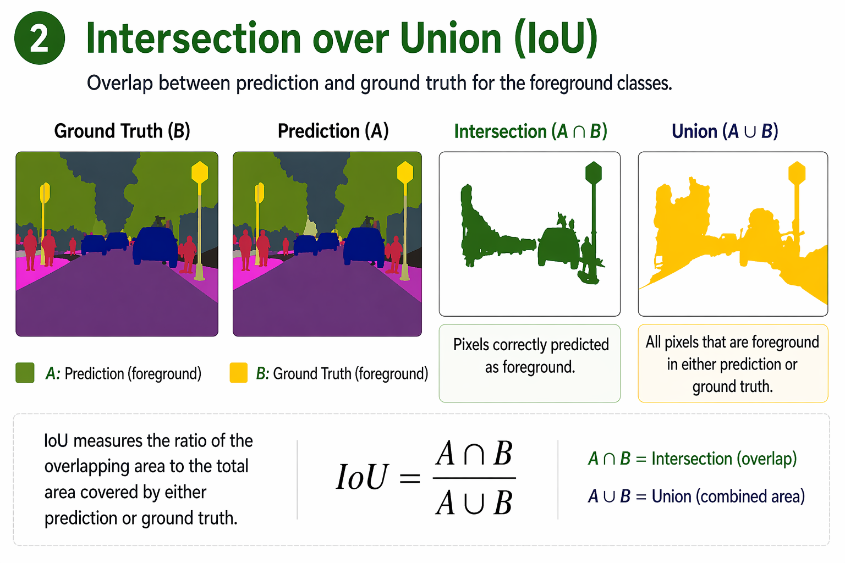
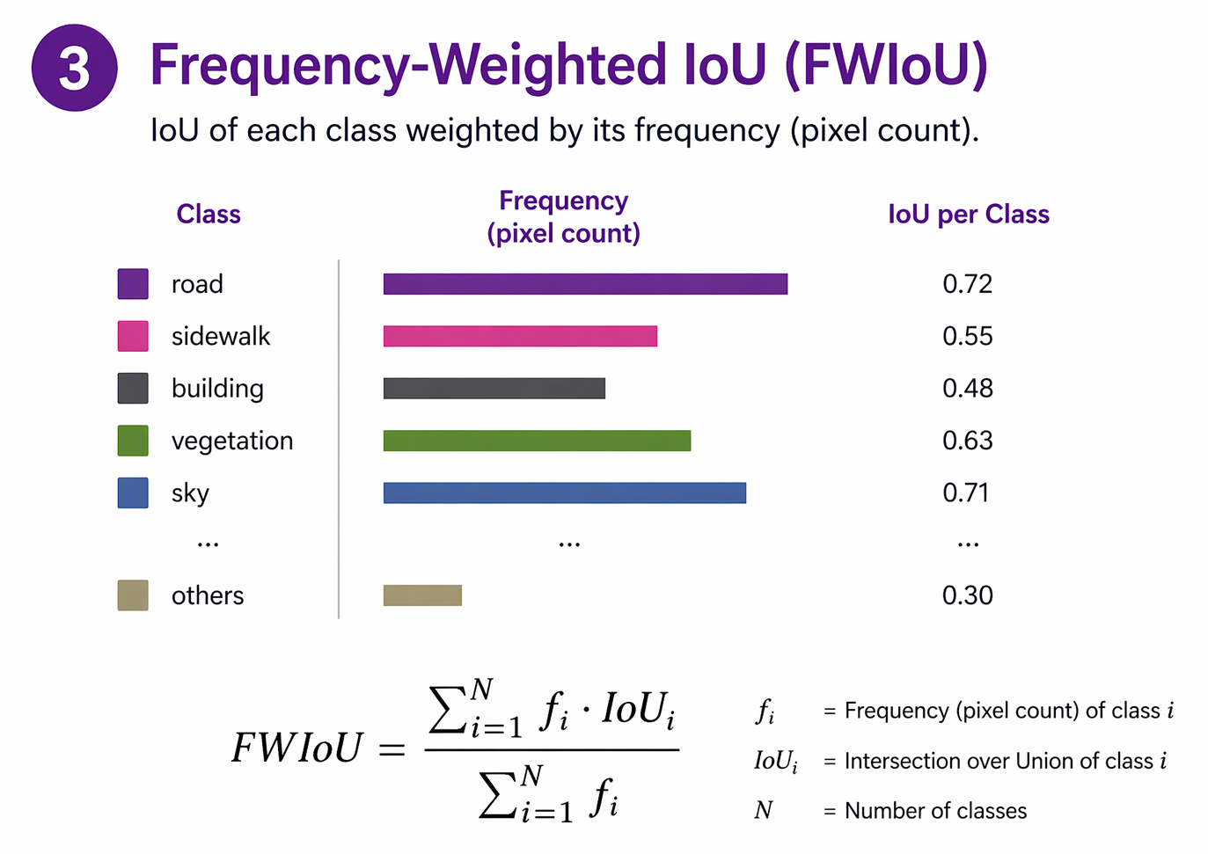
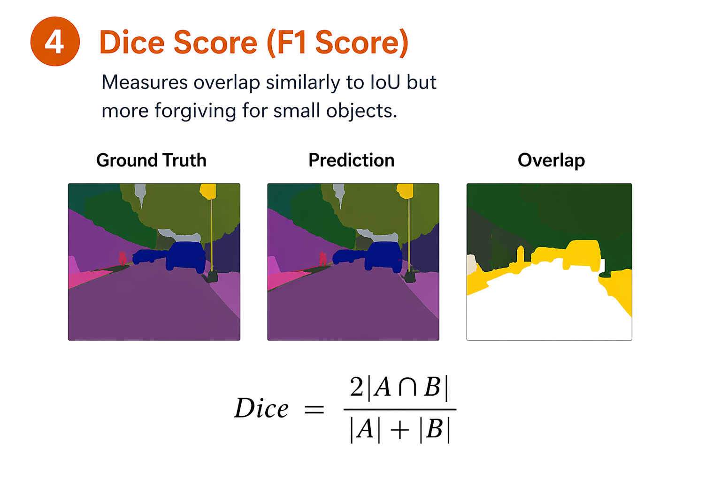
Metrics
05

Slide 6
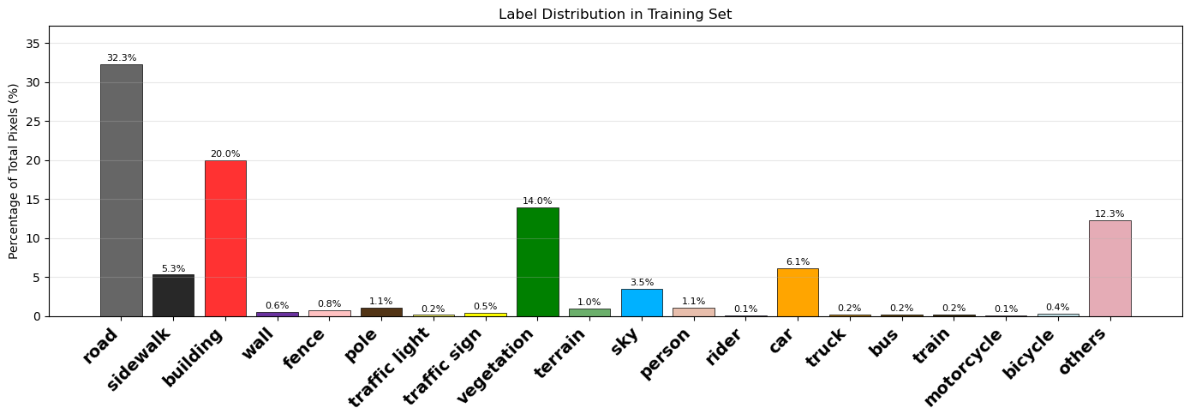
Exploring Data
Class imbalance changes how we read the metrics:
1. Pixel accuracy can look strong even when rare classes are missed.
2. mIoU is stricter because every class contributes to the score.
3. FWIoU reflects overall scene coverage by weighting frequent classes.
06

Slide 7
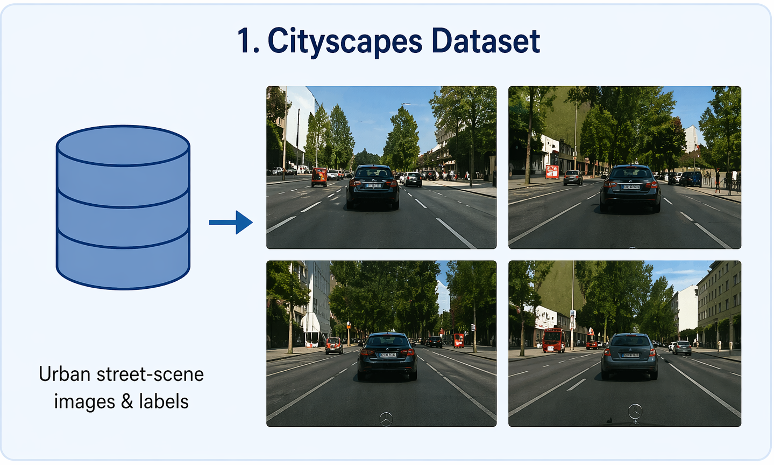
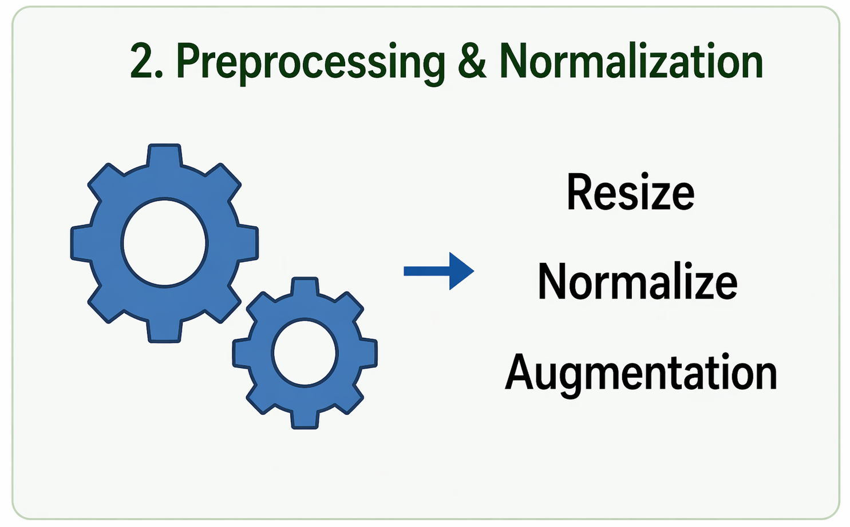
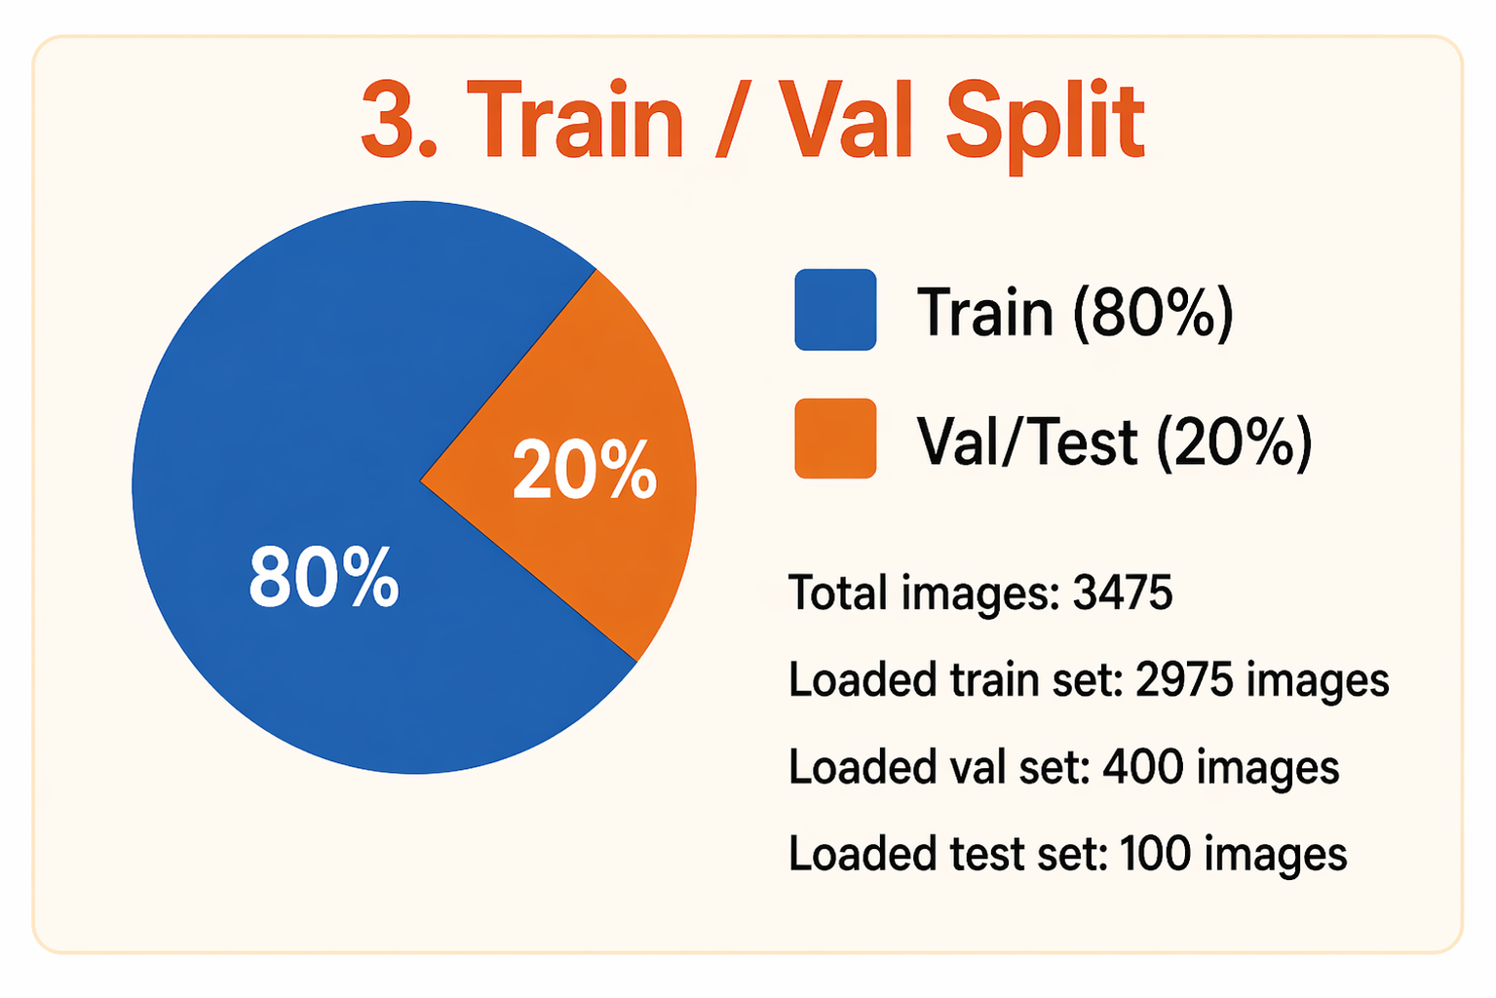
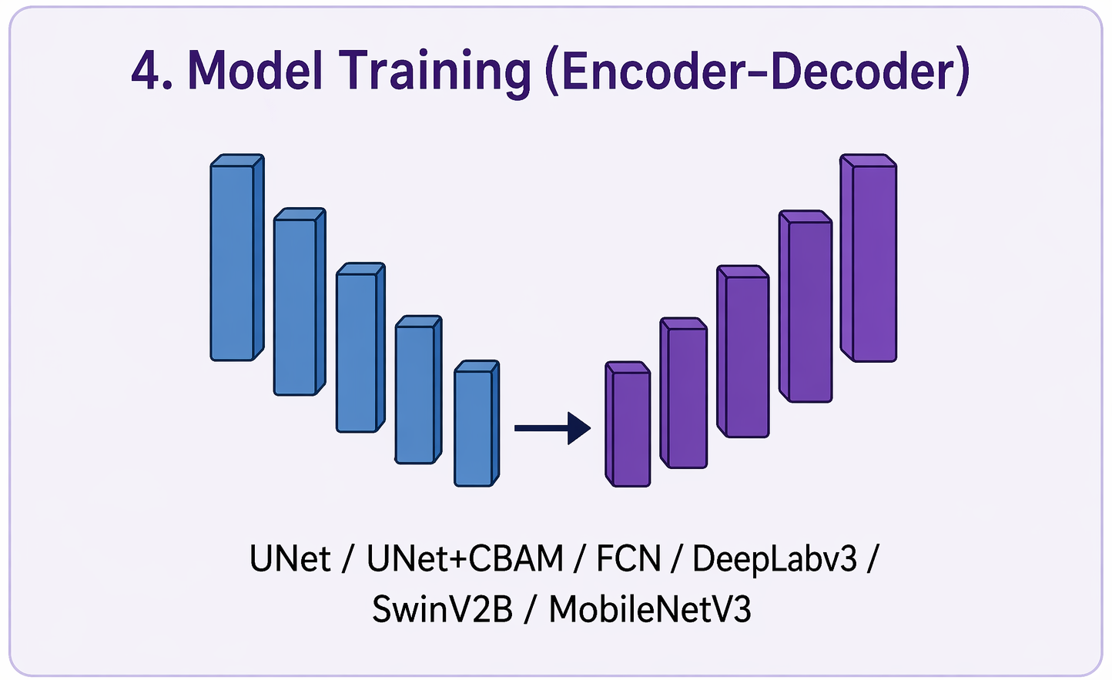
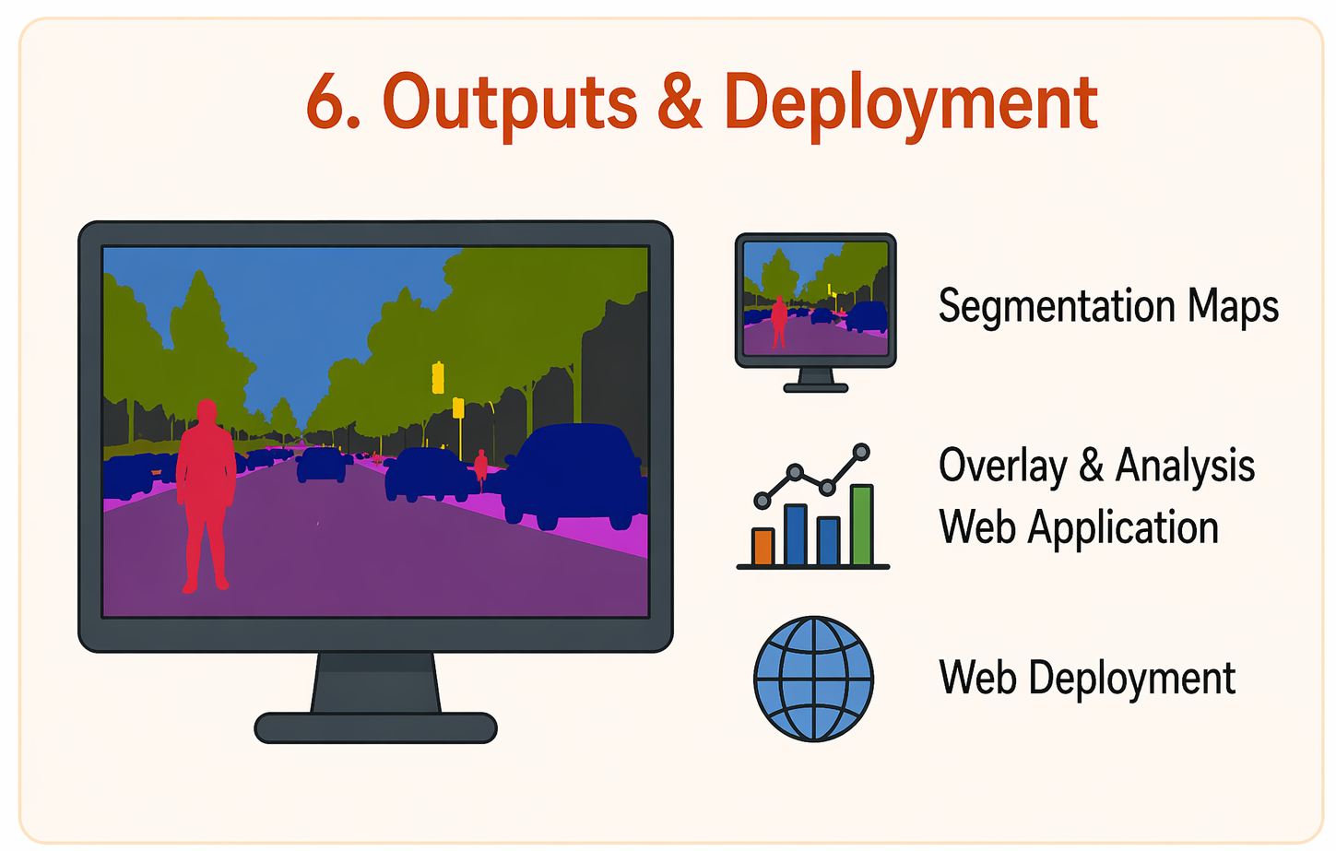
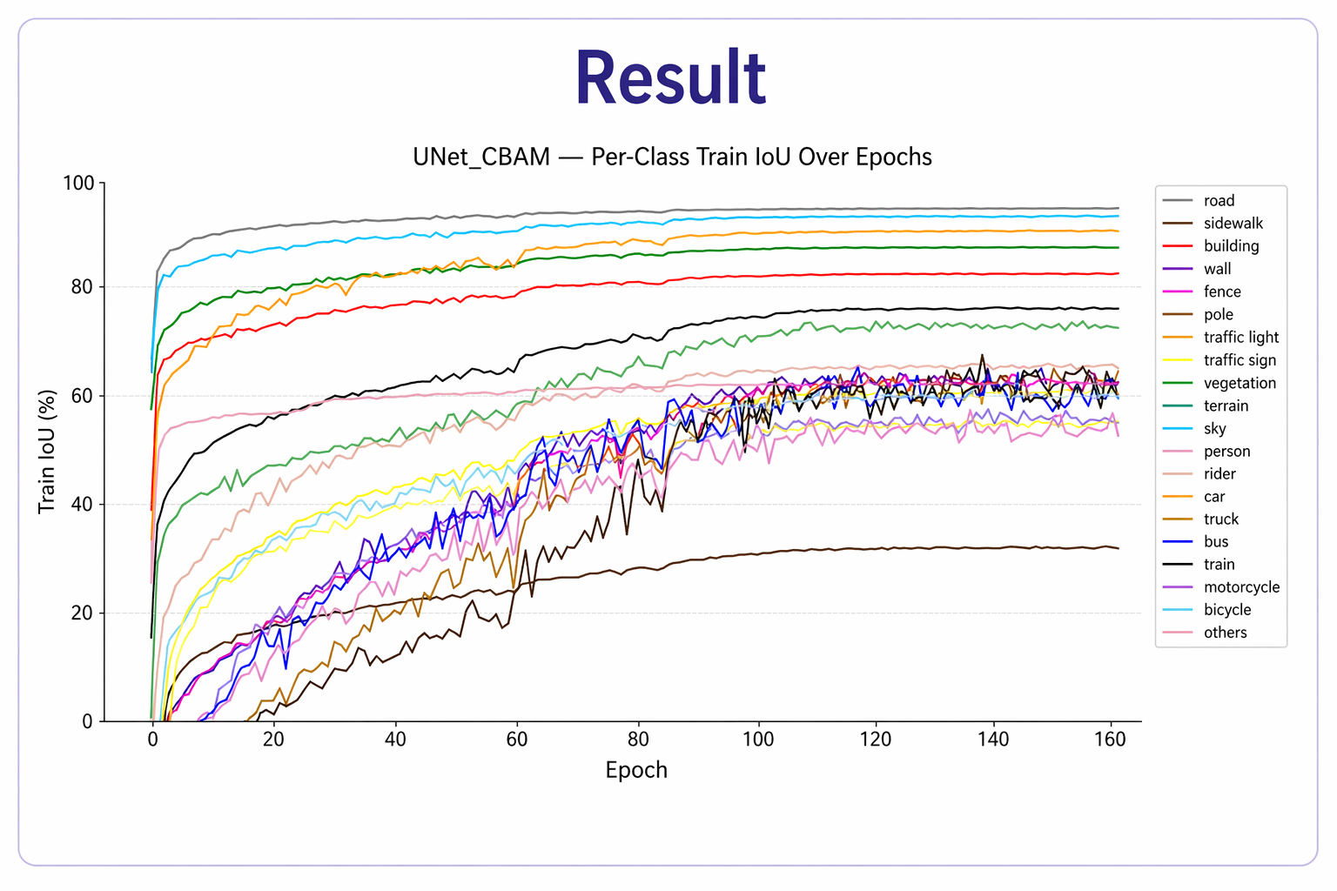
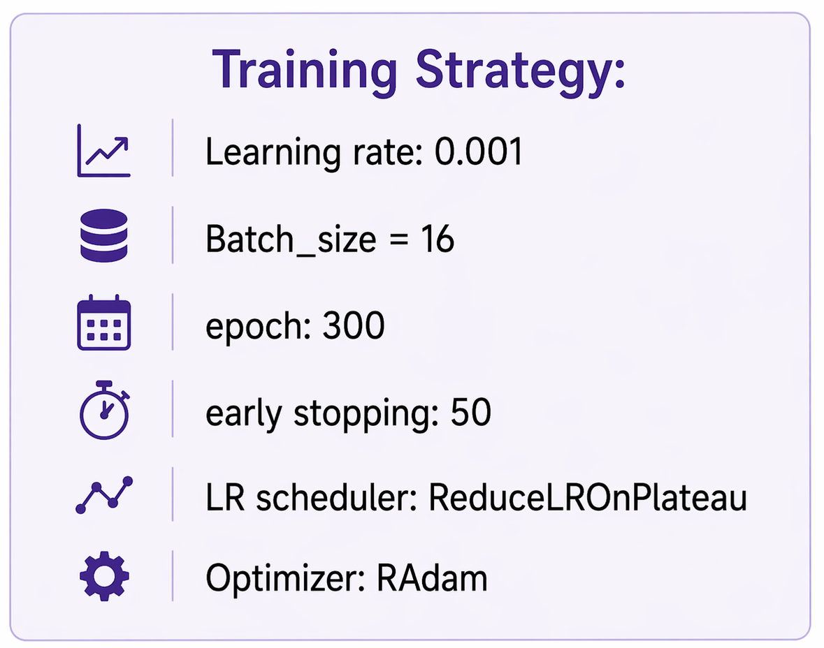
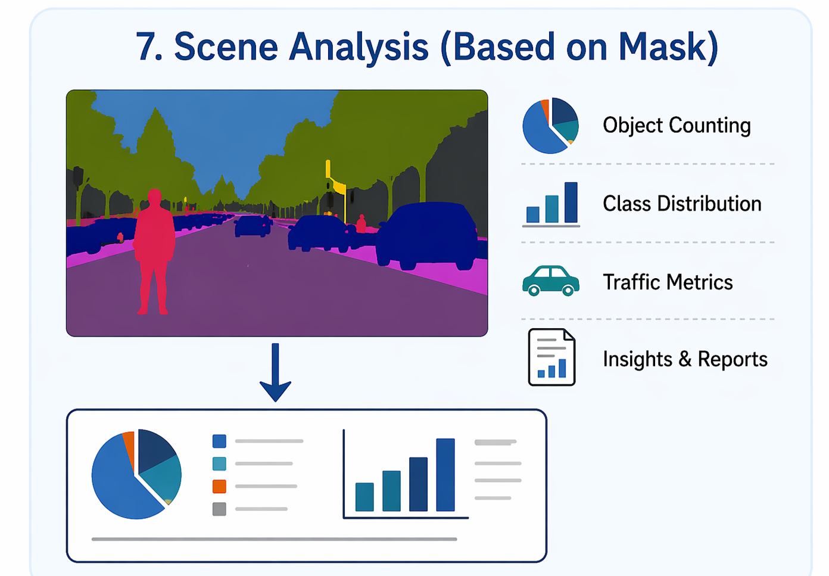
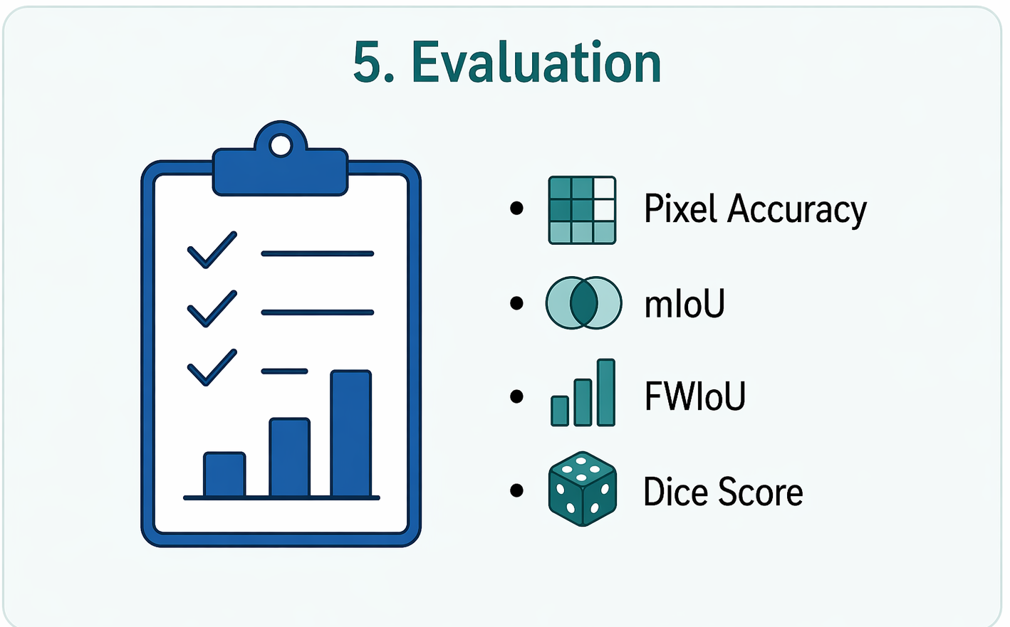
Model Training Workflow
07

Slide 8
Results: Model Comparison
Model | Params | Loss ↓ | Pixel Acc ↑ | IoU ↑ | FWIoU ↑
UNET | 49,925,268 | 0.256 | 0.897 | 0.667 | 0.817
UNET_CBAM (OURS) | 49,936,314 | 0.238 | 0.903 | 0.686 | 0.824
SWINV2B* | 87,159,308 | 0.445 | 0.828 | 0.429 | 0.716
FCN* | 32,956,500 | 0.278 | 0.897 | 0.646 | 0.818
YoLoV11* | 3,166,964 | 0.321 | 0.879 | 0.591 | 0.791
MobileNet_V3* | 3,221,368 | 0.331 | 0.878 | 0.584 | 0.791
DeepLabV3* | 60,995,688 | 0.283 | 0.895 | 0.641 | 0.751
UNet + CBAM achieved the lowest loss and strongest overall IoU/FWIoU in this comparison.
08

Slide 9
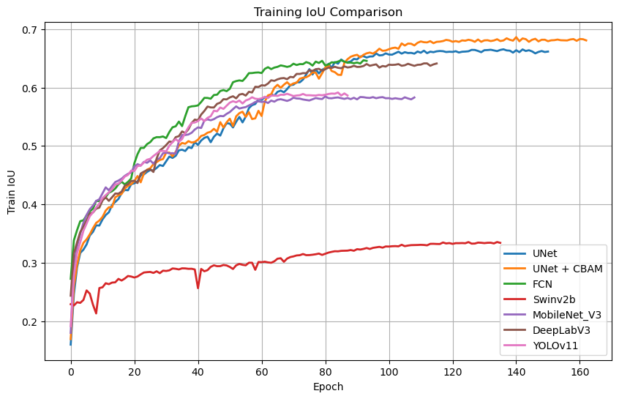
Results: Training IoU Comparison
09

Slide 10
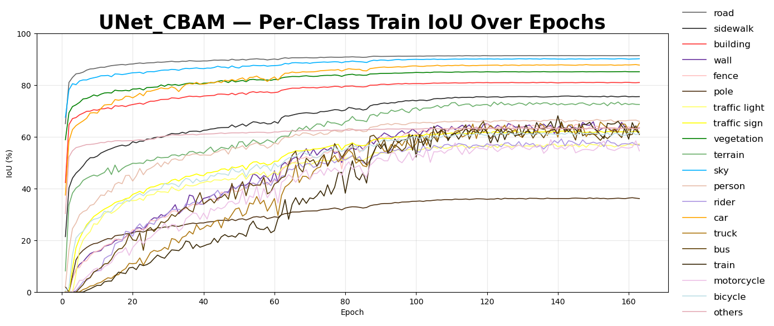
Results: Per-Class IoU Over Epochs
10

Slide 11
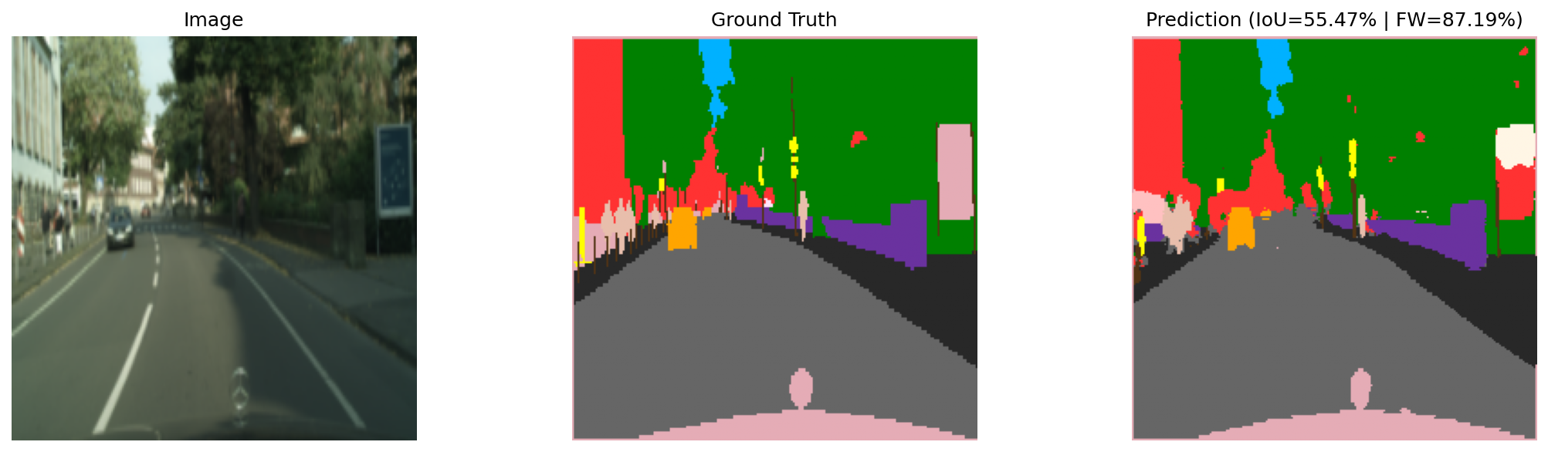
Results: Qualitative Prediction
Prediction
IoU = 55.47%
FW = 87.19%
IMAGE
Ground Truth
Qualitative output: the model captures large regions well while smaller or rare objects remain harder to segment precisely.
11

Slide 12
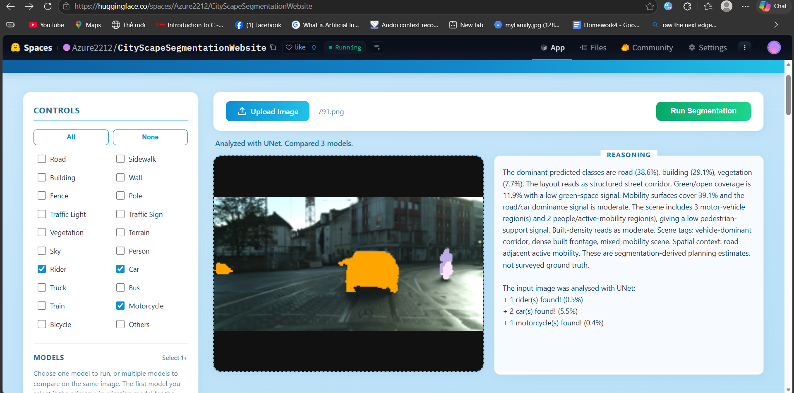
Application: Website Demo
Web app capabilities
• Upload an image
• Select a model
• Run segmentation
• View overlay + counts
• Support scene analysis
https://huggingface.co/spaces/Azure2212/CityScapeSegmentationWebsite
12

Slide 13
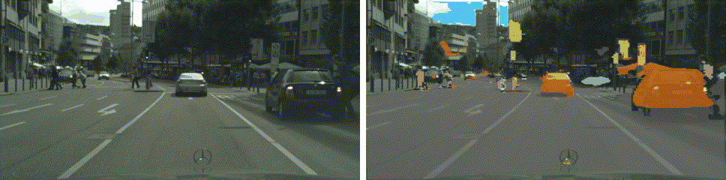
Potential Applications
Semantic segmentation turns raw video into structured scene awareness for autonomous systems.
The model can focus on driving-relevant classes such as road, cars, people, signs, sky and vegetation.
Human view
Model / vehicle view
13

Slide 14
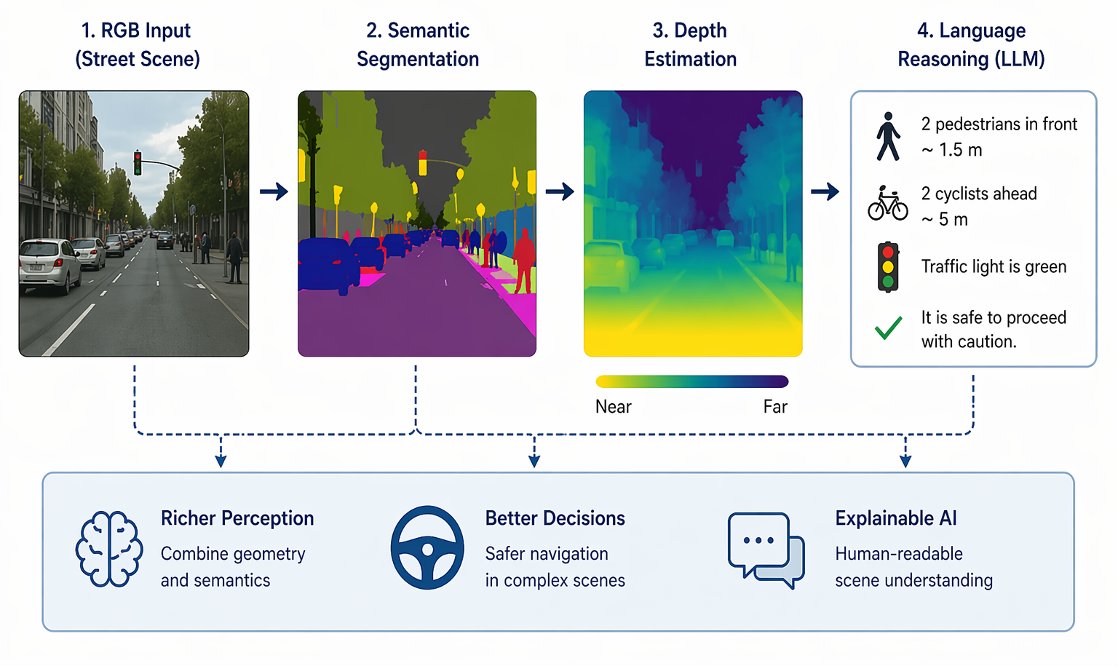
Future Work: Richer Scene Understanding
14

Slide 15
Conclusion
Pixels → masks → scene analysis
Project takeaways
• Built and evaluated Cityscapes semantic-segmentation models across multiple architectures.
• UNet + CBAM produced the strongest overall result in our comparison.
• Class imbalance shows why IoU and FWIoU matter more than accuracy alone.
• The web app connects segmentation output to practical mask-based scene analysis.
• Future work adds depth, video context, and LLM-based reasoning.
15

Slide 16
References
Project resources
• Cityscapes Dataset: https://www.cityscapes-dataset.com/
• Hugging Face Space: Cityscape Segmentation - a Hugging Face Space by Azure2212
Core Models & Architectures
• U-Net (Ronneberger et al., 2015)
• CBAM Attention (Woo et al., 2018)
• Fully Convolutional Networks (Long et al., 2015)
• DeepLab / Atrous Convolution (Chen et al., 2017)
• MobileNetV3 (Howard et al., 2019)
• Swin Transformer V2 (Liu et al., 2022)
Segmentation & Scene Understanding
• Cityscapes Dataset (Cordts et al., 2016)
• PSPNet (Zhao et al., 2017)
• SPGNet (Cheng et al., 2019)
• Height-Driven Attention (Choi et al., 2020)
• Panoptic Segmentation (Kirillov et al., 2019)
Supporting Work
• Semantic Segmentation Survey (Guo et al., 2018)
• Hybrid CRF Analysis (Mottaghi et al., 2013)
Thank you!
16

